Slide 1
The Impact of Brand on Decision-making Process
in Context of Lux Segment
Key words: brand identity, luxury market, decision-making
Student: Svetlana Supranovich
Associate Professor, SEM HSE SPB: Julia Trabskaia

Slide 2
Introduction
Purpose
Research gap and practical relevance
…. to examine and clarify the relationship between dimensions of brand identity and decision-making process and investigate repurchase intention for Russian market consumers in the luxury context.
…. despite the impact of brand identity factors on understanding customer behavior, there are no empirical studies that examine the impact of luxury brand identity and attractiveness, especially from the perspective of younger customers in Russia. Moreover, despite significant growth in the luxury jewelry sector, there is relatively little performance of the company that researched in this industry.

Slide 3
Research question and tasks
How does a brand influence on a consumer decision-making?
Identify features of the luxury market, especially in Russia
Build a relationship model of perception, satisfaction and marketing performance in the luxury context
Identify key factors in of brand identity and the luxury market
Identify the relationship between Brand Identity factors, customer engagement and intent to purchase a luxury product

Slide 4
Literature review

Slide 5
Literature review
Consumer behaviour
Consumer behavior reflects the totality of consumer decisions to acquire, consume and dispose of goods, services, activities, experiences, people and ideas in decision making over time (Hoyer et al, 2012).
In general, it can be described as the actions of the consumer in relation to the object of the relationship (Solomon M., 2006).
The theory of planned behaviour – TPB, was proposed by A. Eisen (1991) as an extension of TRA to account for conditions where people do not have full control over their behaviour.

Slide 6
Literature review
The study of the parameters of return visits has been studied by many researchers.
Oliver, 1980, 1997 - a concept that has been widely discussed in the literature on consumer behavior
The discussion caused an important resonance among tourism researchers both conceptually and methodologically (Kozak, 2001; Ryan, 1995; Yuksel and Yuksel, 2001)
Y.Kim, M. Kim, T.Ruetzer & J. Taylor - give a hypothetical model and assumptions that visitor satisfaction can be predicted by perceived value, the intention to return to it can be predicted by perceived value, the intention to return to it can be predicted by satisfaction.

Slide 7
Literature review
Visitor satisfaction can be predicted by perceived value
Repeat purchase can be predicted by perceived value
Repeat purchase can be predicted by satisfaction
REVISIT INTENSION = REPURCHASE
Resource: Y.H.Kim, M.Kim, T.Ruetzler & J.Taylor

Slide 8
Literature review
Luxury market analysis
Russian luxury market is not studied enough from the prospective of repurchase intentions for luxury goods.
Luxury goods - emphasize their power in society
Russian buyers tend to prefer offline purchases of luxury products. The impulses to buy online comes only through the brand
Attitude of young customers has increased (Deloitte )
In view of those significant perspectives, significant amount of explores are to examine how to anticipate key determinants of clients' buy aim (Chattalas, 2015), intention (Keng, 2007), responsibility (Kim, 2006), loyalty (Li, 2012) and attitude (Lee and Hwang, 2011) towards luxury brands

Slide 9
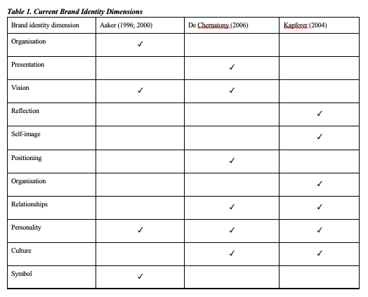
Literature review
Brand identity
There are a few models of brand identity, every one of which incorporates various qualities.
The most popular are:
Brand Identity System (D.A. Aaker, USA)
Brand Personality Prism (Jean-Noel Kapferer, France)
Chernatony Brand Character Model (L. De Chernatony, Joined Realm)
4D Branding (T. Stray, Sweden)
Brand Wheel (Bates Around the world, USA)
Resource:

Slide 10
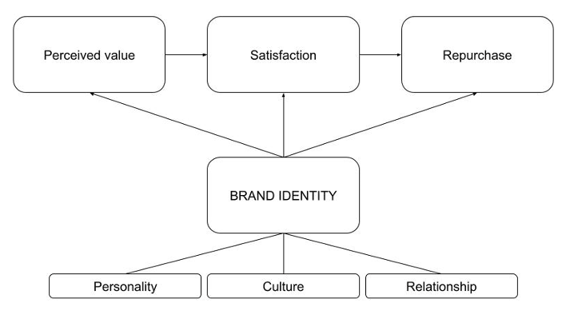
Theoretical Framework

Slide 11
Hypothesis
Following hypothesis were suggested according to theoretical model:
Brand identity is positively related to brand satisfaction in the luxury segment.
Brand identity is positively related to repurchase intention in the luxury segment.
Personality has an impact on repurchase intention in the luxury segment.
Culture has an impact on repurchase intention in the luxury segment.
Relationship has an impact on repurchase intention in the luxury segment

Slide 12
Methodology
Objective | Method
The survey conduction | Quantitative data – online questionnaire
Analysis of empirical data | Factor and regression analysis with SPSS, statistical tests
Interpretation of the outcomes | Summary drawing of results
A quantitative report was directed in view of a formalized web-based study of future and current purchasers of luxury brands. (the investigation of purchaser discernment in many works like Dubois, Duquesne, 1993; Koronaki et al., 2017 )
Subjective exploration procedures are helpful in figuring out a subject's points of view and give bits of knowledge into perspectives and discernments (Neelankavil, 2015).

Slide 13
Data and measurements
Research analyses two groups of people
Subsample 0
Subsample 1
people who would like to buy in luxury segment
people who are already customers of luxury brands
“Are you a consumer of luxury goods?”
Respondents chose one of the following statements: 1) I buy / have luxury goods (jewellery, clothes, shoes, accessories); 2) I am not, but I would like / plan to.

Slide 14
Data and measurements
214 survey questionnaires were collected;
People aged 18 to 25;
Male and female from Saint-Petersburg and Moscow (approx. 50/50%).
Sample 0 (would like to buy in luxury segment ) – 106 responses
Sample 1 (who are already customers of luxury brands ) – 108 responses

Slide 15
Data and measurements
Only 30% have a brand that they are only loyal for
Purchasing various types: clothes (34%), then accessories (22%) and others from 10-18% - perfumes, jewellery, shoes.
66% online shopping
Considering purchasing luxury brands for major events in personal life and holidays as the most appropriate time
Important factors of lux products: Product quality, Exclusiveness, Brand history/legend/ awareness, Brand “faces” (from 151 to 174 answers per factor), leisure activity is shopping (200 answers), visiting cultural institutions (theatres, museums, exhibitions, etc.) - 161 answers.
The individuals analyzed in this study vary in terms of regularity of returning to the same brand, type of luxury item, method of purchase, occasion of luxury purchase.

Slide 16
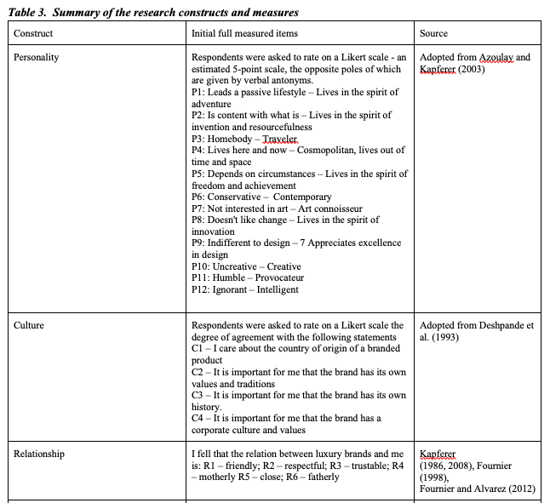
Data and measurements
The questionnaire comprises 23 items and socio-demographic variables.
Five-point Likert scales (Strongly Disagree=1 and Strongly Agree=20) were used to measure the constructs, in a way this format better conforms to linear models, thus providing higher criterion validity (Weijters et al., 2010).

Slide 17
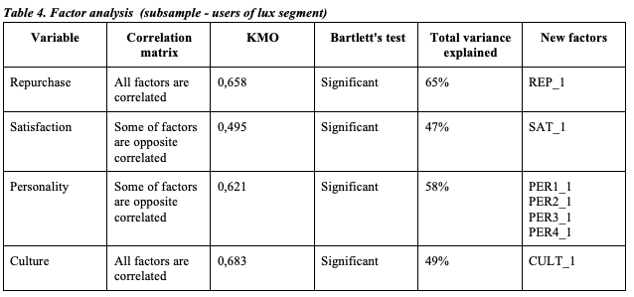
Findings and discussion
people who are already customers of luxury brands (Subsample 1)
Firstly factor analysis was implemented:
Repurchase (from 3 items to 1)
Satisfaction (from 3 items to 1)
Personality (from 12 items to 1)
Culture (from 4 items to 1)
* Relationship (measured with 1 item)

Slide 18
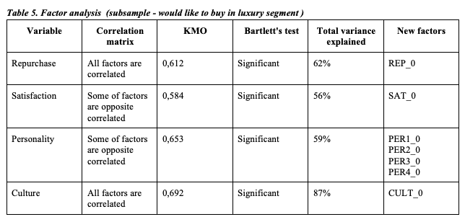
Findings and discussion
people who would like to buy in luxury segment (Subsample 0)
Firstly factor analysis was implemented:
Repurchase (from 3 items to 1)
Satisfaction (from 3 items to 1)
Personality (from 12 items to 1)
Culture (from 4 items to 1)
* Relationship (measured with 1 item)

Slide 19
Findings and discussion
people who are already customers of luxury brands (Subsample 1)
After carrying out factor analysis for both samples, a new bases with variables was created to build the regression models.
Regression model for Subsample 0
Regression model Subsample 1
Curve fitting analysis – the dependent variables “Repurchase” and “Satisfaction'' have a linear dependence with all parameters
“Satisfaction”
R-square – 34,5%
Durbin-Watson criterion – 1.990
ANOVA model is significant
The beta coefficient - positive affect
No multicollinearity
VIF is less than 10
“Repurchase”
R-square – 28,1%
Durbin-Watson criterion – 1.560
ANOVA model is significant
The beta coefficient- positive affect
No multicollinearity
VIF is less than 10
Curve fitting analysis – the dependent variables “Repurchase” and “Satisfaction'' have a linear dependence with all “Culture” and “Personality”, but with “Relationship” – a quadratic one.
“Satisfaction”
R-square – 5%
Durbin-Watson criterion – 1.974
ANOVA model is significant
The beta coefficient - positive affect
No multicollinearity
VIF is less than 10
“Repurchase”
R-square – 6%
Durbin-Watson criterion – 1.723
ANOVA model is significant
The beta coefficient- positive affect
No multicollinearity
VIF is less than 10

Slide 20
Conclusion
The following conclusions can be drawn about the difference between the groups of respondents and their behaviour towards the luxury segment.
Subsample 0
Subsample 1
people who would like to buy in luxury segment
people who are already customers of luxury brands
Both satisfaction and intention to repurchase are affected by the cultural factor. Its influence is small, but still present, and this may be the impulse for further research to test the influence on large samples.
PER3_0 and PER2_0 are completely insignificant, therefore they were excluded from the regression model.
Based on the outcome relation between satisfaction, repurchase and relationship is absents.
The influence on dependent variables was different:
“Culture” and “personality” has an impact on Satisfaction + Personality impact consists of PER1_0 and PER2_0
Only “culture” has an impact on Repurchase intention

Slide 21
Conclusion
The brand influences consumer decision making and there is a connection between brand identity and decision making process (repurchase intention)
Cultural aspect is very important for both subsamples. Marketers in the luxury goods sector will benefit from this study's findings by gaining a better "understanding of their customer's expectations and intentions, which will lead to more effective strategies for maintaining a competitive advantage."
Young respondents pay attention to collaborations with art of luxury brands, on their product designs and on luxury brands who reflect freedom and aren't afraid to be an artist, to be in creation mode every day

Slide 22
Conclusion
H1 | Brand identity is positively related to brand satisfaction in the luxury segment | Confirmed
H2 | Brand identity is positively related to repurchase intention in the luxury segment | Confirmed
H3 | Personality has an impact on repurchase intention in the luxury segment | Confirmed
H4 | Culture has an impact on repurchase intention in the luxury segment | Confirmed
H5 | Relationship has an impact on repurchase intention in the luxury segment | Rejected

Slide 23
Limitations
The sampling frame that does not cover the entire territory of Russia and may for that reason limit the generalisation capability of the research findings;
The current review was performed considering just constructs of satisfaction and repurchase intention in a model
Current factors of Brand identity is not fully described the whole phenomena

Slide 24
Future studies
This examination needs product statements, so further exploration ought to underscore specific brands or item groups;
The variables (factors) should be taken into account in further studies, for example, family status, race, etc, which might influence customers' buying behaviour for a more unambiguous market division;
There are more factors that influence consumers’ repurchase intention towards luxury goods. Further researches should give consideration to independent factors to examine the inquiries under the point, for example, feelings and brand knowledge.

Slide 25
References
Aaker, J.L., Garbinsky, E.N. and Vohs, K. (2011). Cultivating Admiration in Brands: Warmth, Competence, and Landing in the ‘Golden Quadrant’. SSRN Electronic Journal. doi:10.2139/ssrn.1961808.
Aaker, J.L. (1997). Dimensions of Brand Personality. Journal of Marketing Research, 34(3), pp.347–356.
Ajzen, I. (1991). The Theory of Planned Behavior. Organizational Behavior and Human Decision Processes, 50(2), pp.179–211. doi:10.1016/0749-5978(91)90020-T.
Chattalas, M. and Shukla, P. (2015). Impact of value perceptions on luxury purchase intentions: a developed market comparison. Luxury Research J., 1(1), p.40. doi:10.1504/lrj.2015.069806.
Dubois, B. and Duquesne, P. (1993). The Market for Luxury Goods: Income versus Culture. European Journal of Marketing, 27(1), pp.35–44. doi:10.1108/03090569310024530.
Dubois, B. and Duquesne, P. (1993). The Market for Luxury Goods: Income versus Culture. European Journal of Marketing, 27(1), pp.35–44. doi:10.1108/03090569310024530.
Ghodeswar, B.M. (2008). Building brand identity in competitive markets: a conceptual model. Journal of Product & Brand Management, 17(1), pp.4–12. doi:10.1108/10610420810856468
Han, Y.J., Nunes, J.C. and Drèze, X. (2010). Signalling Status with Luxury Goods: The Role of Brand Prominence. Journal of Marketing, 74(4), pp.15–30. doi:10.1509/jmkg.74.4.15.
Hansen, J., & Wänke, M. (2011). The abstractness of luxury. Journal of Economic Psychology, 32(5), 789-796. http://dx.doi.org/ 10.1016/j.joep.2011.05.005
Huber, F., Herrmann, A., & Wricke, M. (2001). Customer satisfaction as an antecedent of price acceptance: results of an empirical study. Journal of Product & Brand Management, 10(3), 160-169.
Jung Choo, H., Moon, H., Kim, H., & Yoon, N. (2012). Luxury customer value. Journal of Fashion Marketing and Management: An International Journal, 16(1), 81-101. http://dx.doi.org/10.1108/13612021211203041
Keller.K.L, 2001. Building customer based brand identity: A blueprint for creating strong brands, s.l.: Marketing Science Institute.
Kapferer, J.-N. and Bastien, V. (2009). The specificity of luxury management: Turning marketing upside down. Journal of Brand Management, 16(5-6), pp.311–322. doi:10.1057/bm.2008.51.
Keng, C. J., Huang, T. L., Zheng, L. J., & Hsu, M. K. (2007). Modeling service encounters and customer experiential value in retailing: An empirical investigation of shopping mall customers in Taiwan. International Journal of Service Industry Management, 18(4), 349-367.
Kim, W. G., Lee, Y. K., & Yoo, Y. J. (2006). Predictors of relationship quality and relationship outcomes in luxury restaurants. Journal of Hospitality & Tourism Research, 30(2), 143-169.
Kim, M.S. and Hunter, J.E. (1993), “Attitude-behaviour relations: a meta-analysis of attitudinal relevance and topic”, Journal of Communication, Vol. 43 No. 1, pp. 1001-1142.
Knapp, D.E. (2000), The Brand Mindset, McGraw-Hill, New York, NY, pp. 33, 36, 103.
Lee, J. H., & Hwang, J. (2011). Luxury marketing: The influences of psychological and demographic characteristics on attitudes toward luxury restaurants. International Journal of Hospitality Management, 30(3), 658-669.
Okonkwo, U. (2009). Sustaining the luxury brand on the Internet. Journal of Brand Management, 16(5-6), pp.302–310. doi:10.1057/bm.2009.2
Serdari, T. (2015). Kapferer on Luxury Brands Can Grow Yet Remain Rare. Luxury, 2(2), pp.127–132. doi:10.1080/20511817.2015.1099351.
Srinivasan, Dr.R., Srivastava, Dr.R.K. and Bhanot, S. (2014). A Study of the antecedents of purchase decisions of luxury brands. IOSR Journal of Business and Management, 16(5), pp.98–114. doi:10.9790/487x-165298114.
Tuškej, U., Golob, U. and Podnar, K. (2013). The role of consumer–brand identification in building brand relationships. Journal of Business Research, 66(1), pp.53–59. doi:10.1016/j.jbusres.2011.07.022.
Veblen, T.B. and Howells, W.D. (1965). The theory of the leisure class. N.Y.: Kelley.
Vigneron, F., & Johnson, L. W. (1999). A review and a conceptual framework of prestige-seeking customer behaviour. Academy of Marketing Science Review, 1(1), 1-15.
Vigneron, F., & Johnson, L. W. (2004). Measuring perceptions of brand luxury. The Journal of Brand Management, 11(6), 484-506.
Wiedmann, K. P., Hennigs, N., & Siebels, A. (2007). Measuring consumers' luxury value perception: A cross-cultural framework. Academy of Marketing Science Review, 7(7), 333-361.
Wiedmann, K. P., Hennigs, N., & Siebels, A. (2009).Value ‐ based segmentation of luxury consumption behaviour. Psychology & Marketing, 26(7), 625-651.

Slide 26
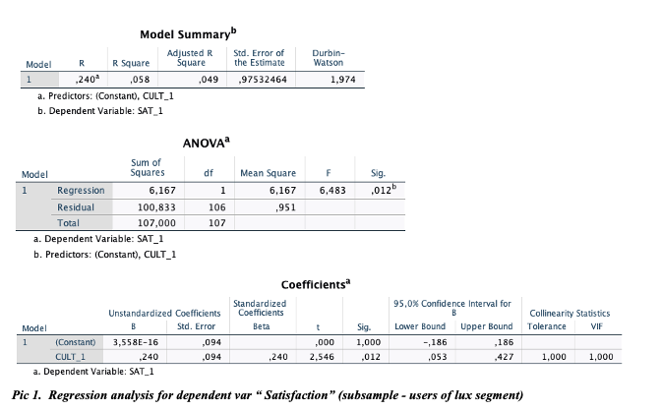
Appendix

Slide 27
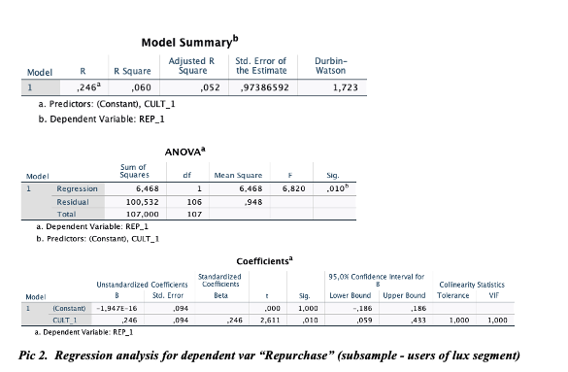
Appendix

Slide 28
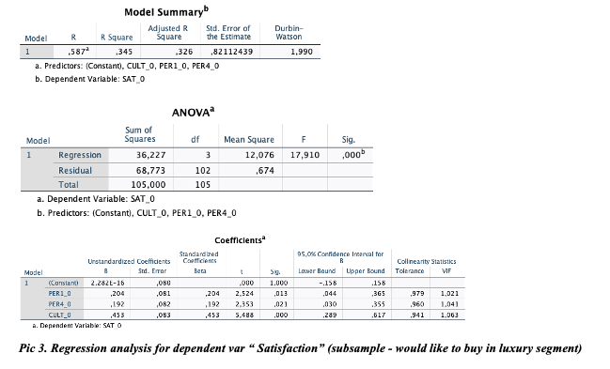
Appendix

Slide 29
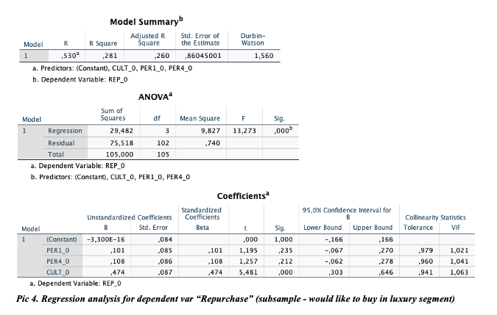
Appendix

Slide 30
Journals
International Journal of Culture, Tourism and Hospitality Research
Journal of Cultural Economics
Journal of Services Marketing
Consumer Behaviour in Tourism and Hospitality

Slide 31
The paper developed in conformity with publication rules in “Consumer Behavior in Tourism and Hospitality” journal. “Consumer Behaviour in Tourism and Hospitality (CBTH) is an international, double-blind peer reviewed journal, that fosters multidisciplinary and interdisciplinary research in consumer behaviour in tourism and hospitality” (official website). The journal especially seeks to nurture collaborative work among researchers in marketing and consumer behaviour. There were some studies in this journal regarding processes, biases, and behaviours related to decision-making process. Research paper uploaded to the journal and waiting for confirmation.
Journal website: https://www.emeraldgrouppublishing.com/journal/cbth
Requirements: Author guidelines

