Slide 1
Achieving Performance Outcomes: The Relationships between Museum Innovation, behavioral intentions and Satisfaction
Nikita Tryapkin, Elena Zelenskaya, Julia Trabskaya and Anastasia Sinitsyna
ntryapkin@hse.ru
Saint-Petersburg, 2022

Slide 2
Research Motivation
The pandemic COVID-19 has severely disrupted the activities of many organizations, including museums that were closed for a long time and began to move to a digital environment without specific preparation. Thus, this crisis increases the museum needs to innovate, digitalize their activities and collections.
However, сan innovation affect performance? How will visitors react to this?

Slide 3
Research Motivation
Two answers to this question:
Some museum managers talk about the dangers of such development. The main argument of this group of managers is that introducing new technologies, the museum is moving away from its original functions (preservation, education, etc.) and, as a result, harms them (Blasco López, Recuero Virto & San-Martín, 2019). Moreover, they stress that it is ineffective methods for communication to the public (Hume, 2015).
«MCD [Mobile Communication Devices] use will encourage visitors to be mindful about things other than the exhibition, reducing the attention paid to the exhibits and their engagement with museum content» (Hughes & Moscardo, 2017)
The development of innovation allows museums to improve visitor’s experience, offer new unique products and enhance satisfaction through the perceived customization of the exhibition (Zollo, Rialti, Marrucci & Ciappei, 2021)

Slide 4
Research question and main definitions
Research question: How perceived innovativeness influence visitor’s satisfaction and behavioral intentions?
Perceived firm innovativeness is “the consumer's perception of an enduring firm capability that results in novel, creative, and impactful ideas and solutions for the market” (Kunz, Schmitt & Meyer, 2011: 817).
Behavioral intention – «the customer’s anticipation of the likelihood of acting in a certain way...: to say positive things about the provider, recommend the provider to other customers, remain loyal to the provider, spend more with the provider, and pay premium prices» (Radder & Han, 2015: 458).

Slide 5
Theoretical framework
Cognitive-affective-conative model of loyalty (Oliver, 2014)
The cognitive phase implies that the consumer compares the proposed product or service with existing analogues from competitors: a comparison of certain characteristics (price or some conditions).
The affective part is the gradual development of consumer satisfaction (emotions or feelings), which is formed on the basis of use of a product or service (Oliver, 1999). Satisfaction does not come by itself. It is formed on the basis of the satisfaction of those expectations or beliefs that appeared in the cognitive phase (Westbrook, 1980).
As for the conative phase of loyalty, certain intentions are formed for some product or service which satisfy the consumer tastes (Taylor & Baker, 1994). As a general rule, under intentions, it is customary to consider a repeat purchase or a revisit, a recommendation to others (Chiou, Droge & Hanvanich, 2002).
Affective loyalty
Cognitive loyalty
Conative loyalty
+
Satisfaction
+
Perceived innovativeness
Behavioral intention
+

Slide 6
Hypotheses
H1: Perceived innovativeness has a positive effect on visitor satisfaction in the museum setting;
H2: Perceived innovativeness has a positive effect on behavioral intentions in the museum setting;
H3: Visitor satisfaction has a positive effect on behavioral intentions in the museum setting.
Affective loyalty
Cognitive loyalty
Conative loyalty
+
Satisfaction
+
Perceived innovativeness
Behavioral intention
+

Slide 7
Methodology
Data
Respondents were randomly selected from among those who had already completed their visit to the exhibition and agreed to take our survey. The questionnaire consisted of questions aimed at identifying visitor perceptions of museum innovation, satisfaction, and behavioral intentions. The cross-sectional data collected through a survey of museum visitors in Faberge museum. The analysis is based on 429 questionnaires.
Measurement
The questionnaire will be formed on the basis of an analysis of the literature and existing scales for measuring the used constructs. This paper assumes the use of existing theoretical constructs that measure museum innovativeness (Kim, Tang & Bosselman, 2018), satisfaction (Tsaur, Wang, Liu, & Huang, 2019) and behavioral intentions (Zeithaml et al., 1996; Bonn et al., 2007).
Analysis
Confirmatory factor analysis was used in order to form our three constructs (Perceived innovativeness, Satisfaction and Behavioral Intentions) from items. Further, we applied structural equation modeling (SEM) to test direct and indirect relationships between our constructs. All calculations performed in the software “Stata” using command sem

Slide 8
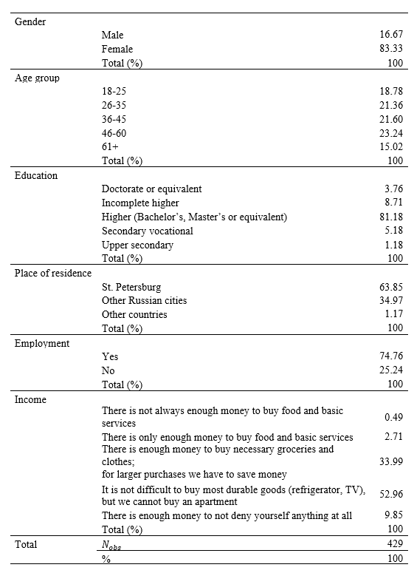
Descriptive statistic
In most cases, women took part in the survey (approximately 83%). The age groups of respondents are in roughly equal proportions. Approximately 64% of respondents were from St. Petersburg. 75% of respondents have a job. As for the education level, almost 81% of the visitors had completed higher education.

Slide 9
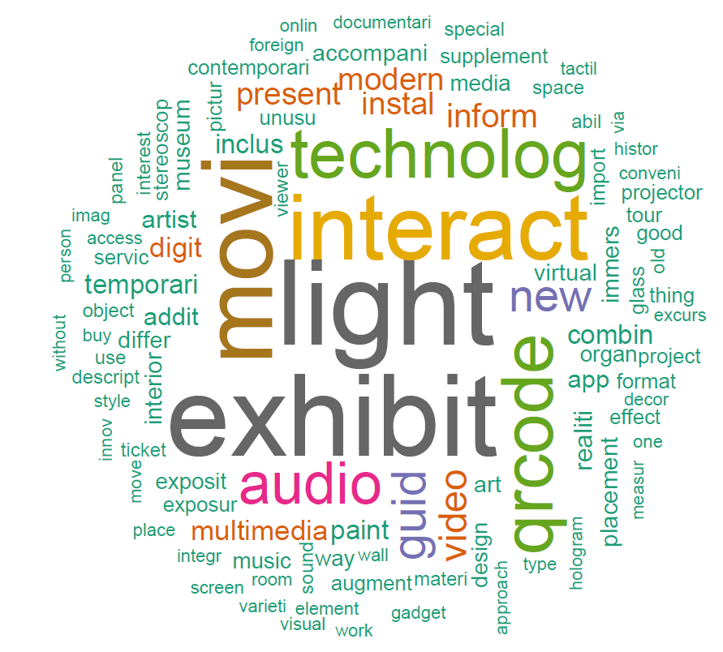
A word cloud of consumer perception of innovations in museums
Open-ended question "What do you think innovation in museums is?“
Museum visitors perceive innovation as:
The existence of temporary exhibitions (sometimes noted about little-known artists);
Lightning (backlighting, lighting effects, etc.)
Multimedia, technology and digitalization
Interactivity as crucial thing for museum innovations

Slide 10
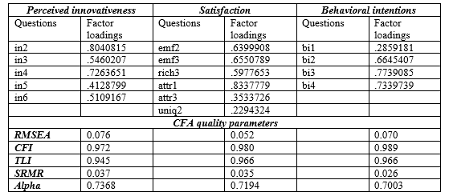
Confirmatory factor analysis
Factor loading of a variable means the extent to which the variable is related to a given factor.
Firstly, these are CFI (Comparative Fit index) and TLI (Tucker–Lewis index) indicators. Their values should be in the range between 0.9 (better 0,95) - 1. «CFI and TLI are incremental fit indices that compare the fit of a hypothesized model with that of a baseline model (i.e., a model with the worst fit)» (Xia & Yang, 2019: 409).
Secondly, RMSEA is an absolute fit index, in that it assesses how far a hypothesized model is from a perfect model. RMSEA value should be < .05 or at least < 0.08 that indicates a “close fit” and a «reasonable model–data fit» (Xia & Yang, 2019: 409). The null hypothesis is that the RMSEA equals .05.
The third criteria is SRMR is «an absolute measure of fit and is defined as the standardized difference between the observed correlation and the predicted correlation. Because the SRMR is an absolute measure of fit, a value of zero indicates perfect fit». A value must be less than .08 which means a good fit (David A. Kenny, 2020)*.
Cronbach alpha measures reliability, or internal consistency. Cronbach’s alpha will tell you how closely related a set of test items are as a group. A frequently cited acceptable range of Cronbach's alpha is a value of 0.70 or above

Slide 11
Structural equation modelling
Satisfaction directly influences behavioral intentions. It means that higher the level of satisfaction is associated with the increase in revisit intention and a willingness to recommend;
Perceived innovativeness positively influences behavioral intentions;
Perceived innovativeness positively influences satisfaction;
Perceived innovativeness through a higher level of satisfaction (mediator) influences behavioral intentions.
Notes: * Significant at 10%, ** Significant at 5%, *** Significant at 1%. Model fit: RMSEA 0.050; CFI 0.944; TLI 0.932; SRMR 0.049. Source: authors’ calculations.

Slide 12
Main Findings
The analysis performed showed that perceived innovativeness strongly and positively affects the further satisfaction of visitors and their behavioral intention to return, recommend, etc. Based on this, it becomes possible to say that innovations can increase not only the satisfaction from museum visiting, but also encourage them to re-visit and recommend this museum to friends or acquaintances. In short, it can build loyalty. In addition, here we can say that innovations have a positive effect on market performance, since this indicator includes constructs of satisfaction and repurchase or recommendations.
Visitor’s Satisfaction leads to the formation of their further intentions to revisit or recommend the museum or the exhibition. As a consequence, it is crucial for museum managers to monitor and achieve satisfaction in order to enhance museum performance outcome. One of the ways, as the analysis showed, is the implementation of innovations in the museum setting.

