Slide 1

INTERNATIONAL STUDENT
EXCHANGE
HSE SAINT-PETERSBURG
Center for International Cooperation
HSE University St. Petersburg

Slide 2
WHAT IS INTERNATIONAL STUDENT MOBILITY?
An international student mobility (student exchange) programme is an opportunity to study for one semester or full academic year at a partner university abroad.
Student exchange participants earn ECTS credits, do internships and project work at the host university according to their individual study plan.
No tuition fees at the host university.
Tuition is mostly in English language.
  International student mobility 2020

Slide 3
WHY DO I WANT TO PARTICIPATE?
Cross-cultural communication and foreign language skills
Broader Academic Prospective
Study at a top university for free
Friends and future business partners from all over the world
Added Value of International
Experience
  International student mobility 2020

Slide 4

WHAT KIND OF EXCHANGE PROGRAMMES ARE THERE?
EXCHANGE WITH PARTNERS OF HSE-ST. PETERSBURG CAMPUS
QTEM PROGRAM
Coordinator: Maria Neklyudova, mneklyudova@hse.ru
⏳
1
1
EXCHANGE WITH
UNIVERSITY-WIDE PARTNERSHIPS
(Coordinated by campus in Moscow, studyabroad.hse.ru)
1
1
INDIVIDUAL ARRANGEMENT FREEMOVER
DOUBLE DEGREE PROGRAM
Coordinator: Anna Andreyanova, aandreyanova@hse.ru
1
1
INTERNATIONAL
SUMMER / WINTER SCHOOLS
  International student mobility 2020

Slide 5






EXCHANGE PROGRAMMES OPPROTUNITIES HSE SAINT-PETERSBURG
Within the framework of the international agreements of the HSE, St. Petersburg there are exchange programs with 100+ universities in 30 countries. For some of these programs there is an opportunity to receive a scholarship
GREAT BRITAIN
4 university
GB
15 countries
58 universities
EU
EU:
Vietnam, China, Malaysia Indonesia and South Korea, Japan 21 universities
ME
ASIA
Asia:
North Africa and Middle East:
Lebanon and Morocco
2 universities
AM
Middle
America:
Mexico
1 university
  International student
  mobility 2020 I 5

Slide 6
PARTNER UNIVERSITY
SUMMER SCHOOLS
HSE ST PETERSBURG PARTNER UNIVERSITY
SUMMER SCHOOLS
spb.hse.ru/io/studyabroad/school
How to apply?
Choose the Summer School destination from one of the HSE partner universities
Apply during the application period, some are already open
The topic of Summer School should be relevant to your specialization
Scholarships are available on the “first come first served” basis
St. Petersburg Scholarship for Summer School Application Process
spb.hse.ru/io/studyabroad/scholarship
Submit the application form with the following documents:
Acceptance letter from Summer School
Letter of support from your Academic supervisor
2. The ISG makes a decision about the candidates
3. Selected students will be informed by Center for International Cooperation and start their preparations for the Summer School
NB: SOME ADMINISTRATIVE CHANGES MIGHT OCCUR!
CHECK THE WEBSITE FOR THE UPDATES
⏳
1
1
  International student mobility 2020

Slide 7
CAN I PARTICIPATE?
Who can participate?
Requirements:
state-funded and fee-paying students
Russian citizens and international students
at least 4 sessions completed for Bachelors (after 1st year)
At least 1 session completed for Masters (after 1st semester)
Post-grads if there are spots available
good academic performance
knowledge of the language at the level required (English - at least B2)
language certificates, if required in the host institution
no failed exams
preference is given to students who have not previously participated in exchange programs
  International student mobility 2020

Slide 8
HOW CAN I PARTICIPATE?
spb.hse.ru/io/studyabroad/callfall2020-21
List of documents:
preliminary individual study plan (IUP) for each university applying agreed with the study office with a minimum workload of 9 ECTS per quarter / 18 ECTS per semester.
motivation letter (400 - 600 words)
a file with a estimated budget
3. Formal Application signed by Academic Supervisor
4. Expenses Estimation Form
5. Language proficiency evidence:
valid International Language Certificate e.g. TOEFL/IELTS/CAE
- HSE Independent English Test result
- Language proficiency confirmation from an appropriate authority, e.g. authorized test center, language school, HSE language instructor etc
6. (Optional) Supplementary documents proving applicant’s extracurricular / research / teaching activities
  International student mobility 2020

Slide 9
HOW CAN I PARTICIPATE?
spb.hse.ru/io/studyabroad/callfall2020-21
List of documents:
preliminary individual study plan (IUP) for each university applying agreed with the study office
a letter of recommendation in English in free form from the professor/tutor of the Higher School of Economics - St. Petersburg (except teachers of English language)
motivation letter (400 - 600 words)
a file with a estimated budget
International language certificate (if available), or a certificate issued and signed by a teacher of a foreign language at the Higher School of Economics - St. Petersburg
Application to participation in the exchange program, agreed with the academic supervisor and study office
  International student mobility 2020

Slide 10
WHAT DO I DO?
FINAL
Start preparing for departure, if application was approved
STEP 5
Get a result of your application at the e-mail address
STEP 4
Wait for the results of the call
STEP 3
Prepare the documents necessary for application and apply online on time (January 27 – March 1, except early deadline)
STEP2
Choose the appropriate mobility program in one of the partner universities and agree your choice with study office and academic supervisor
STEP 1
Decide to participate in student exchange and learn the information provided on the website spb.hse.ru/io/studyabroad
  International student mobility 2020

Slide 11
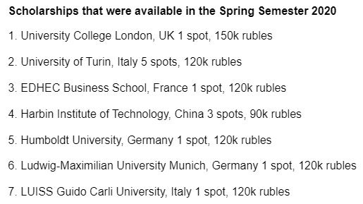
HOW MUCH WILL I SPEND?
spb.hse.ru/io/studyabroad/scholarship
Students must pay the following expenses related to participation in the program:
VISA FEES
.
📎
TRAVEL COSTS
✈
No tuition fees at the host university!
DOCUMENTS DELIVERY
🔖
🔑
ACCOMODATION
📈
PERSONAL EXPENSES
Types of SCHOLARSHIPS
HSE St Petersburg Scholarship Automatically to best applicants Specific list of partners Amount depends on the country | Third-party support Erasmus+ FIRST The final decision on granting the scholarship remains with the host institution.
  International student mobility 2020

Slide 12

GET MORE INFORMATION AND APPLY ONLINE!
NEW CALL is open from January 27 to March 1, 2020
spb.hse.ru/io/studyabroad
  International student mobility 2020

Slide 13
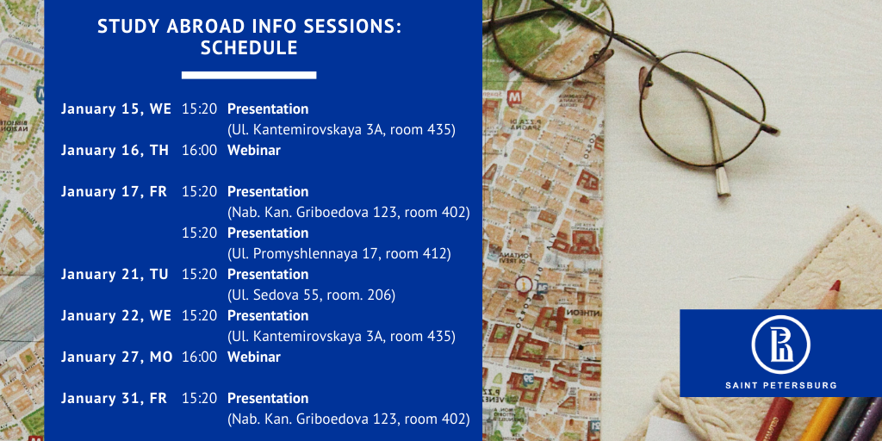
Schedule of the information sessions in January 2020
  International student mobility 2020

Slide 14
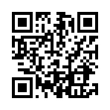
GOT QUESTIONS?
Personal consultations available at the CIC on appointment
CONTACT INFORMATION:
CENTRE FOR INTERNATIONAL COOPERATION
Address: Naberezhnaya Kanala Griboedova, 123A, office 215
Phone: +7 (812) 644-59-10 ext. 61245 (Daria) / 61595 (Julia) / 61747 (Evgeniya)
Email: outgoingspb@hse.ru
  International student mobility 2020

