Slide 1



Winning the Love of Young Consumers:
An Exploratory Study of Russian Premium Brands
Strakhov Alexander
Smirnova Elizaveta
Okulova Olga
1

Slide 2
INTRODUCTION
RESEARCH CONTEXT AND RESEARCH MOTIVATION
RESEARCH MOTIVATION:
1. THE RUSSIAN MARKET HAS SEEN AN INCREASE IN THE POPULARITY OF PREMIUM BRANDS AMONG THE YOUTH (E.V.GRUNT ET AL., 2017)
2. The loyalty of Russian customers it yet to be fully gained (country of origin effect), but there is a "window of opportunities" (Vorobieva, Ovchinnikov., 2019).
There is a scarcity of literature on the factors that could boost social consumer fashion brand engagement (Naeem, Ozuem., 2021).
So, the authors intend to examine this research gap by investigating how social strategies performed by brands work and which content is awaited by their customers.
2

Slide 3
To explore the role of the tools used by the brands to develop emotional connections with their young customers by applying Triangular Theory of Love
THE AIM OF
THE RESEARCH
We aim to address gaps in the branding literature and provide practical implications on local and international companies’ marketing strategy.
3

Slide 4
RESEARCH QUESTIONS
RQ1:
What practices are used by Russian premium brands to engage young audiences in relationships and build a strong attachment?
RQ2:
How interpersonal relationships are reflected in the relationship between the brands and their customers?
4

Slide 5
LITERATURE REVIEW
The main attributes of a premium product are higher cost ,quality, and uniqueness of the product; satisfaction of the rational and emotional expectations of customers (Kapferer and Bastien, 2013).
Brand love
Changes in consumer behavior
A work by Shimp and Madden (1988) defined brand love as the intense emotional attachment that consumers feel towards a particular brand.
Fournier (1998) suggested that brand love represents a deep attachment and emotional connection that consumers form with certain brands, leading to strong loyalty (Fournier, 1998)
Skorobogatykh et al., 2023 studied that through the COVID-19 and the withdrawals of foreign brand behavior of consumer has changed to:
1) an online shopping.
2) turning to Russian premium brands.
Siebert et al.'s (2020) research confirms that customers' behavior and content consumption on social networks has also evolved.
Brand Loyalty
Brand-customer relationships
Brand loyalty is the biased (i.e., nonrandom) behavioral response (i.e., purchase expressed over time by some decision-making unit with respect to one or more alternative brands and is a function of psychological (decision-making, evaluative) processes (Jacoby and Kyner, 1973).
People engage in interpersonal relationships through social media for some common cause or intentions, such as getting information on fashion brands (Naeem and Ozuem 2020).
The study of Albert et al. found that brand identification and trust explain approximately 60% of consumers' passion for a brand, with brand identification having the greatest influence.
5

Slide 6

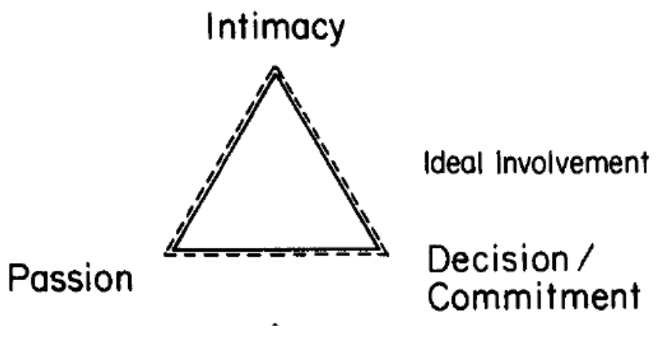
THEORETICAL FRAMEWORK
MAIN THEORY
Sternberg’s Triangulation Theory of Love (1986) describes the degree to which a person is involved in a love relationship depending on the proportions of three components in the relationship
Love consists of three components:
Figure 1. Ideal distribution of components of Love (Sternberg., 1986)
6

Slide 7

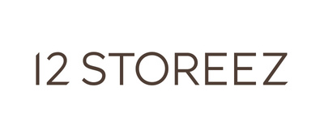





4 brands
3 categories of premium goods
METHODOLOGY
Multiple Case study method
In depth interviews
Developed as an in-depth interview, based on the positions or brand preferences of premium among the Youth respondents
Interview Design: the questions are designed to provide a view from Triangular Theory of Love perspective.
Analytical approach: Inductive the obtained data processed using “coding”, by which it will be separated, conceptualised, and reconnected into insights and also the “Word Cloud” method is used.
Retail
Technologies
Accomodation
11 interview in total (3-4 for each category)
Age:
21-28
9%
91%
7
Questionnaire

Slide 8
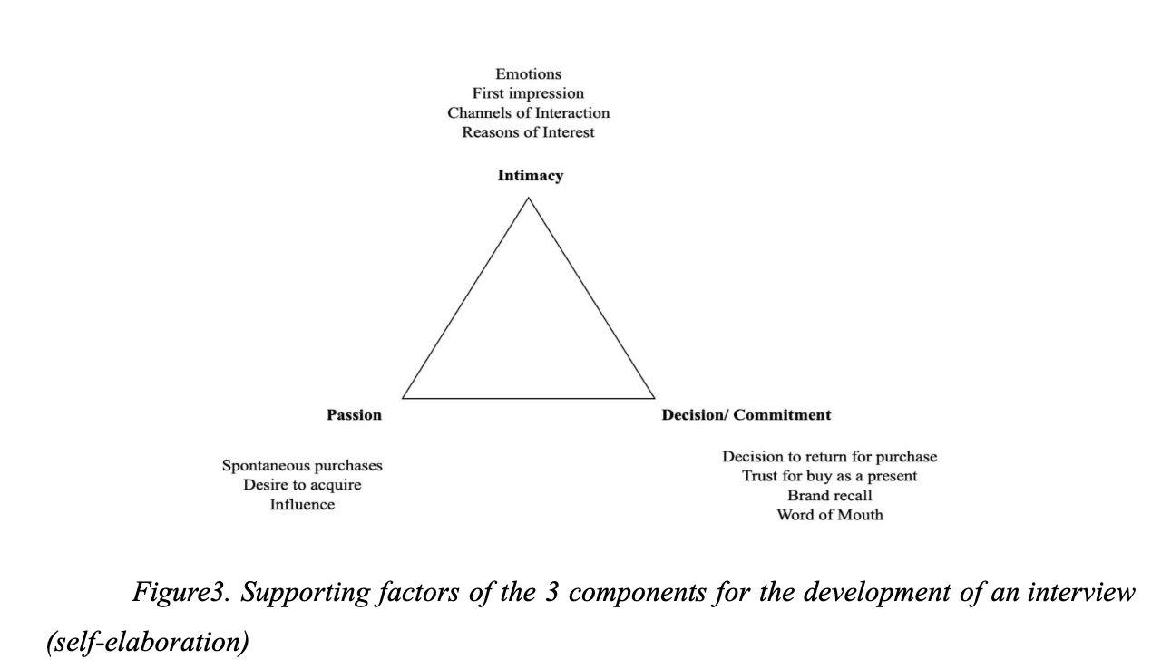
METHODOLOGY
Development of questionaire according to the theory
Figure3. Supporting factors of the 3 components for the development of an interview (self-elaboration)
8

Slide 9
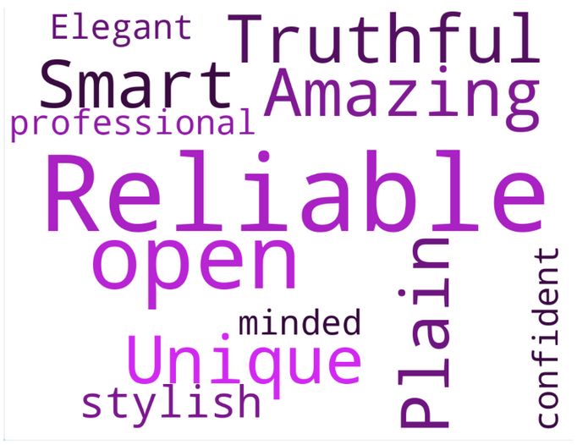
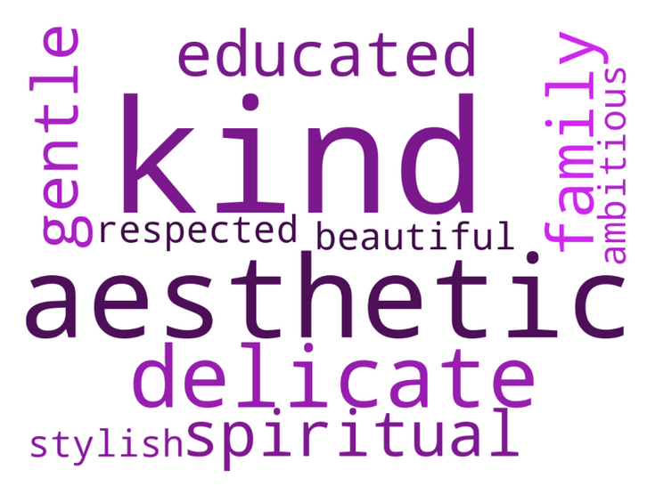
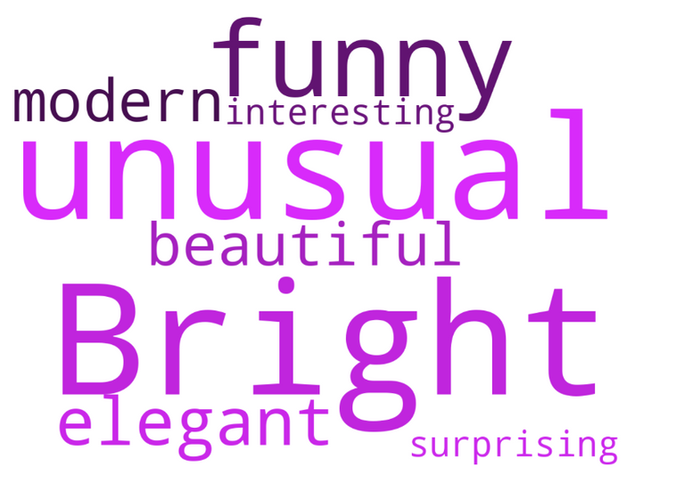
RESULTS
Transferring psychological theory to management
Figure 4.Adjectives related to Bork brand
Figure 3.Adjectives related to 12Storeez
and Present&Simple brands
Figure 5.Adjectives related to Delo Design brand
9

Slide 10
RESULTS
Main insights based on interpretation of interview
1.Intimacy
Attraction to personal content in the brand's channels, for example, about the hobbies of founders
Wide product range and content themes
Provide only essential and key information
Pride in Russian manufacturing
10

Slide 11
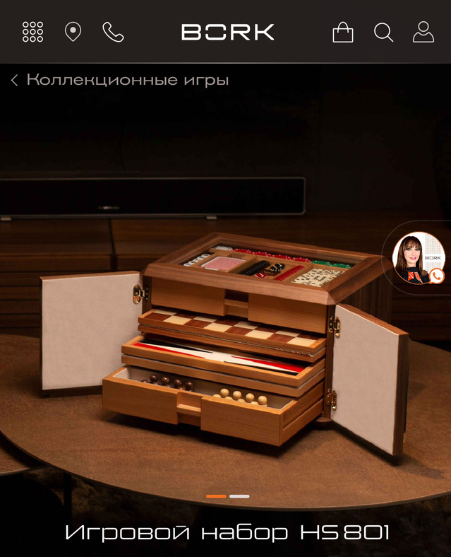
RESULTS
Recommendation to boost intimacy between brand and customers:
More personal content about the founders and top management of the company (this may be the founders hobbies, goals and plans)
Cover different interests and hobbies of clients and broadcast them in brand’s content
Limited emailouts with the most important information and less content on social media
Make an accent on Russian production and Russian origin
Bork chess set
11

Slide 12
RESULTS
Main insights based on interpretation of interview
2.Passion
Beautiful, quality-made shootings and content
Wide range of products, categories, colors drive an interest
Collaborations with bloggers and brands
The ability to evaluate an item from all sides (360 degrees)
“Sunk into the soul”
12

Slide 13
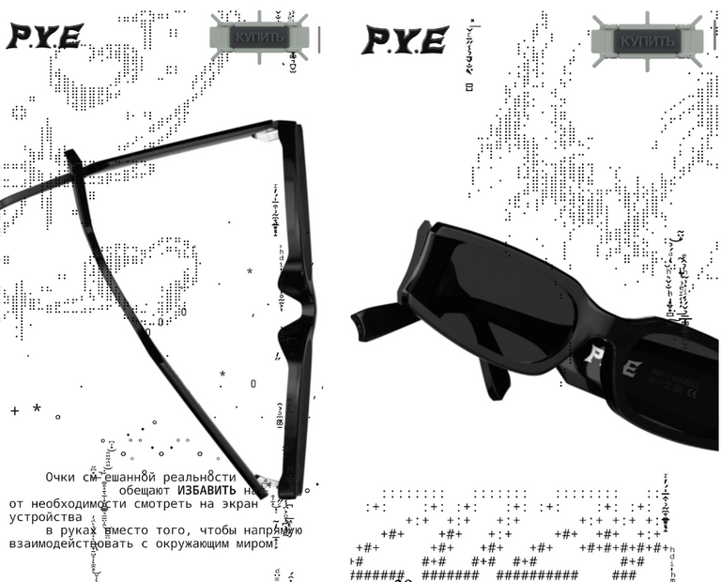
RESULTS
Recommendation to boost passion between brand and customers:
Improve the quality of content, address different topics and customer interests.
Use AR fitting rooms, VR technologies, 360-degree shooting to cover the objections of customers
Collaborate with influences, leaders of opinions, places of city, caffe and restaurants to attract attention
Make more colors, modify models, expand the range of things so that the product will “sink into the soul” of more people
PyeOptics AR opportunity to look
the glasses on 360°
13

Slide 14
RESULTS
Main insights based on interpretation of interview
3. Decision/commitment
a friendly and unbiased atmosphere in the store
an expanded assortment and a large number of product categories
Small products in the brand's assortment for a small price - price discrimination
Brand events
Product and packaging customization
14

Slide 15

RESULTS
Recommendation to boost decision/commitment between brand and customers:
Conduct brand events are truly valued by the customers as they create an element of belonging
Create of a comfortable zone of stay in the shop and adherence to the "Third Place" concept
Expanse the product range for different customer needs. which can evoke a feeling of continuous attachement to a brand
Add more as possible customatiozation
Make small inexpensive products, as an opportunity to buy products from brands every time.
Brand’s invitation to a event on
a social media (Present&Simple)
15

Slide 16
DISCUSSION
Theorethical Contribution
Our study has made an attempt to fulfill the research gap which has been identified by previous researches - Shimp and Madden (1988), Fournier (1998), Mukherjee (2020), Getkate . They pointed out that emotional perspective of brand - customer relations should be more thouroughly studied.
The study enriches the theoretical framework surrounding brand love by detailing how its specific components serve as domains to drive the feeling.
Our study extends the application of the triangular theory of love from interpersonal relationships to consumer-brand relationships to find common patterns that develop and sustain love for a brand, where the love features act in equilibrium.

Slide 17
DISCUSSION
Theorethical Contribution
By applying the theory to the context of Russian premium brands, the research extends our understanding of how brand love perspective can not only analyse perceptions but also be used as strategic tools for strong market positioning of local brands
The results of the study demonstrated that the brands should not only mirror the emotional needs of the consumers but also make attempts to develop their products according to the consumers’ expectations.
This finding contributes to the recent study of Grappi et al. (2024) that emphasized the need to not only explore the perceptions but also suggest the tools of what brands can do to develop emotional attachment.
16

Slide 18


DISCUSSION
Practical Implications
The study offers recommendations for Russian premium brands and other local brands that are interested in setting the right tone of voice and becoming efficient in reaching their target audience.
To summarize, authors suggest to highlight 5 main recommendations
Companies should launch small products for frequent purchases as a way to touch the brand again or give a gift to a loved one;
Brands should produce less content on their media, but use many channels as possible;
Brands should highlight the origin of the brand for customers to be proud of them;
Brands should create assortment and content for the maximum audience within the brand style;
Brands should adjust AR/VR technologies to boost spontaneous purchases.
17

Slide 19
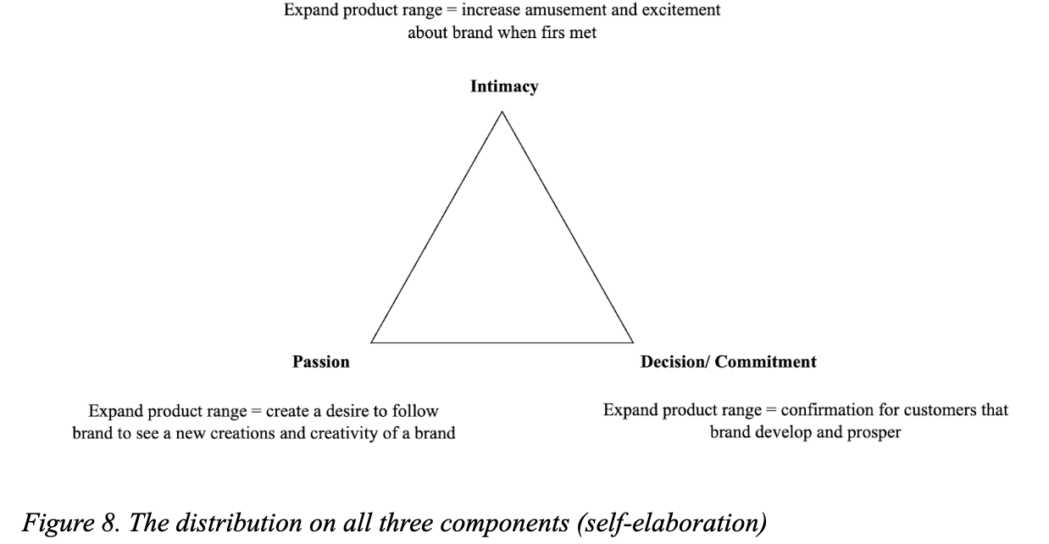
DISCUSSION
Practical Implications
18

Slide 20
DISCUSSION
Practical Contribution
The most optimal tool for correct description of a brand is to represent it as a specific person endowed with characteristics researched by the authors with the help of the technique of "word cloud".
It becomes much easier for customers of companies to describe their emotions and requirements to the market directly, bypassing formalities, because they present brand in the form of a person and are much more articulate about their own desires and preferences in communicating with it.
It makes sense to extend this theory from purely interpersonal relationships to working in the form of "brand-customer"
19

Slide 21
Future research and Limitations
1 It is focused only on several cases of Russian premium brands, which limits the external validity and capacity to generalize the results.
It is deemed important to analyze other premium brands from both a qualitative and quantitative perspective to understand how the aspects of brand love differ within Russian regions, and what would identify patterns for bigger and smaller cities.
2 In-depth interviews were conducted based on the convenience sample method, although the respondents are well-familiar with the brands included in the study
Future research may concentrate on other groups of respondents, primarily those individuals who are not familiar with the brands
3 The study included only currently successful brands
Future research may significantly benefit from both qualitative and quantitative research of the brands that did not manage to ensure sustainable brand love and quitted the market.
4 Future studies will be able to explore the determinants of brand love not only for other premium brands, not also for both international and local mass-market brands (Andhini and Andanawarih, 2022)
20

Slide 22


Q&A

Slide 23
Skorobogatykh, I., Shirochenskaya, I., Timokhina, G., Martuzalieva, Т., & Mkhitaryan, S. (2023). Behavior of Russian Premium Fashion Consumers and Designers after the COVID-19 Pandemic and International Sanctions. Emerging Science Journal, 7, 128–144. https://doi.org/10.28991/esj-2023-sper-010
Vorobieva, A. E., & Ovchinnikov, Y. V. (2019). MECHANISMS OF YOUTH’S SOCIAL PERCEPTION OF GOODS OF THE PREMIUM CATEGORY AND THEIR ADVERTISING. Vestnik Moskovskogo Gosudarstvennogo Oblastnogo Universiteta. https://doi.org/10.18384/2310-7235-2019-3-76-89
Siebert, A., Gopaldas, A., Lindridge, A., & Simões, C. (2020). Customer Experience Journeys: loyalty loops versus involvement spirals. Journal of Marketing, 84(4), 45–66. https://doi.org/10.1177/0022242920920262
Gorohov M.A. (2011). TOVARY KLASSA «PREMIUM»: SUSHCHNOST' I OSNOVNYE HARAKTERISTIKI. Marketing v Rossii i za rubezhom. https://dis.ru/library/541/29361/
Sternberg, R. J. (1986). A triangular theory of love. Psychological Review, 93(2), 119–135. https://doi.org/10.1037/0033-295x.93.2.119
John, D. R., Loken, B., Kim, K., & Monga, A. B. (2006). Brand Concept Maps: A methodology for identifying brand association networks. Journal of Marketing Research, 43(4), 549–563. https://doi.org/10.1509/jmkr.43.4.549
Sondhi, N., & Basu, R. (2022). Profiling the online premium brand consumers based on their fashion orientation. Asia Pacific Journal of Marketing and Logistics, 35(2), 380–397. https://doi.org/10.1108/apjml-07-2021-0492
Arantola, N., & Juntunen, M. (2023). The emergence of a values-based premium private label brand reputation within a multiple-tier brand portfolio. Journal of Product & Brand Management/Journal of Product & Brand Management, 32(7), 1139–1153. https://doi.org/10.1108/jpbm-06-2022-4027
Basu, R., & Sondhi, N. (2021). Online versus offline: preferred retail choice for premium brand purchase. International Journal of Retail & Distribution Management, 49(10), 1447–1463. https://doi.org/10.1108/ijrdm-05-2020-0181
Mukherjee, K. (2019). Social media marketing and customers’ passion for brands. Marketing Intelligence & Planning, 38(4), 509–522. https://doi.org/10.1108/mip-10-2018-0440
Albert, N., Merunka, D., & Valette-Florence, P. (2013). Brand passion: Antecedents and consequences. Journal of Business Research, 66(7), 904–909. https://doi.org/10.1016/j.jbusres.2011.12.009
Mohsin, M. A., & Beltiukov, A. (2019). Summarizing Emotions from Text Using Plutchik’s Wheel of Emotions. Atlantis Press. https://doi.org/10.2991/itids-19.2019.52
Trend Hunter is the World’s Largest Community for Trend Spotting, Cool Hunting, and Innovation. (n.d.). Trend Hunter Inc. https://www.trendhunter.com/about-trend-hunter
Rane, N. L., Achari, A., & Choudhary, S. (2023). ENHANCING CUSTOMER LOYALTY THROUGH QUALITY OF SERVICE: EFFECTIVE STRATEGIES TO IMPROVE CUSTOMER SATISFACTION, EXPERIENCE, RELATIONSHIP, AND ENGAGEMENT. International Research Journal of Modernization in Engineering Technology and Science. https://doi.org/10.56726/irjmets38104
Thompson, J. (2023, February 21). Consumers have humanlike relationships with brands. Business News Daily. https://www.businessnewsdaily.com/2821-consumers-relationships-brands.html
Ashraf, S. F., Li, C., & Mehmood, B. (2017b). A Study of Premium Price Brands with Special Reference to Willingness of Customer to Pay. International Journal of Academic Research in Business & Social Sciences, 7(7). https://doi.org/10.6007/ijarbss/v7-i7/3126
Sethuraman, R., & Cole, C. (1999). Factors influencing the price premiums that consumers pay for national brands over store brands. Journal of Product & Brand Management/Journal of Product & Brand Management, 8(4), 340–351. https://doi.org/10.1108/10610429910284319
Miller, C. J., & Brannon, D. C. (2021). Pursuing premium: comparing pre-owned versus new durable markets. Journal of Product & Brand Management/Journal of Product & Brand Management, 31(1), 1–15. https://doi.org/10.1108/jpbm-02-2020-2769
References:

Slide 24
RESULTS
Interview analysis and recommendations
1.Intimacy
Citation | Interpretation
“I watched an interview with one of the creators of the brand and felt a connection with the personality.” | Customers are attracted to personal content in the brand's channels, for example, about the founders, their hobbies and values. This content shows the details with which customers can relate themselves.
“I expect surprises, because the brand that first specialized in technology began to produce chess and items that I did not expect. And every time I think about what else they will release...” | Wide product range and content themes that brands touch make customers align their hobbies and intentions with a brand.
“No, honestly, I'm not subscribed to social networks. I just have an app, I go there periodically, and I really like to make wishlists..” | Customers may not be subscribed to the brand's social networks. They can be subscribed to the personal pages of the creators of the brand. Every customer is looking for a convenient way of communication.
23

Slide 25
RESULTS
Interview analysis and recommendations
1.Intimacy
Citation | Interpretation
“I subscribed to the Bork mailing list by mail because they do not "spam" — they do not send unnecessary information, on the contrary, they send rare letters with useful news, taking care of the client.” | There is a tendency to consume less content and decrease information noise from the Internet.
“I was very sincerely glad that they exhibited their furniture in Milan. Reaching the international level. Yes, it's nice to realize that Russian design can show itself.” | Russian manufacturers are no longer associated with bad quality. Customers feel proud of Russian brands to keep high standards in high quality and level of services.
24

Slide 26
RESULTS
Interview analysis and recommendations
2. Passion
Citation | Interpretation
“A beautiful picture, first of all. I am an aesthete with my eyes. I really like to come in and watch.” | The desire to purchase a brand is greatly influenced by beautiful shots and content. Clients associate things and objects with themselves and their lives, their apartments.
Their expansion is of endless interest. Starting with the creation of basic household appliances, by 2024 the company is already presenting several separate sections. The appearance of more and more new products makes it necessary to actively monitor the brand.” | Wide range of products, categories, colors surprise and drive an interest. Customers wonder what other products the brand can create and suggest.
“Collaborations are a great tool, indeed, they immediately attract my attention as a consumer.” Sofia from Interview “I love collaborations.” | Customers love collaborations with bloggers and brands, it increases their level of trust and arouses interest.
25

Slide 27
RESULTS
Interview analysis and recommendations
2. Passion
Citation | Interpretation
“I'm the kind of person who needs to see how the thing will sit from different sides. From behind, from the front, from the side.... when they give me a look at the thing from different sides, then it would have motivated me more to buy the thing online.” | For a spontaneous purchase, coldness of mind is also important, and the ability to evaluate an item from all sides in order to understand whether it is 100 percent suitable.
“Usually, when a thing has “sunk into the soul”, when both the model and the material and the color match, I liked everything” | “Sunk into the soul” is a frequent answer about spontaneous purchases, if the model and color and the desired image match with the preferences of the client, then the purchase is made
26

Slide 28
RESULTS
Interview analysis and recommendations
3. Decision/commitment
Citation | Interpretation
“I like to come to the offline store with my mom or my husband. It turns out to be a small holiday. We are always treated to coffee, sweets. You can have a pleasant time and slowly choose the most suitable things.” | A friendly and unbiased atmosphere is important in the store. The store should be convenient for both customers and their attendants. Treats, coffee, and drinks are welcome by customers.
“ Well, I'm thinking about some new models, some new colors. When something new appears, then the brand develops, and long-term relationships are built with it” | Сustomers see an expanded assortment and a large number of product categories as a way to refresh their relationships with brands and see the brand from a new perspective.
“I bought furniture, then it will serve me there for several years. Or just stay with me forever, it will be updated. As much as I would like to refresh my relationship with the brand, it's probably to buy something that changes, something smaller. Well, they also have dishes, some clothes...” | It is important for customers to see small products in the brand's assortment for a small price. This will help the client to touch the brand or give a gift to their loved ones to introduce them to the brand as well.
27

Slide 29
RESULTS
Interview analysis and recommendations
3. Decision/commitment
Citation | Interpretation
“It would be very cool, especially if Bork, for example, invited you to some kind of events after the purchase, some kind of lectures on technology... or about some other things.” | Сustomers would like to participate in brand events, come to the opening of new collections, listen to new products, the history of the brand and meet other clients.
“On the part of the brand, there must be attention to the regular customer. I am pleased that in the offline store they know me by name, they know my size, they can put things that may interest me on sale. I respond with high loyalty and regular purchases.” | Customization is a very pleasant addition to the purchase, evoking a sense of gratitude and affection from customers.
28

