Slide 1
research seminar economy business society
start: online,
ms teams

Slide 3
(1) academic science:
how to do and how to use
social structure of Academia
writing an academic paper
project management
critical reflection of the data

Slide 4
(2) practice in field work
reflection of the methods
development of the research skills
fieldwork
master-classes with
professional sociologists

Slide 5
(3) student’s academic work
assistance with research thesis,
course paper
structure, logic
tips for writing and analysis

Slide 6
(4) reading club
to read a book from
economic sociology field
to discuss main ideas, content
genre/style of writing

Slide 7
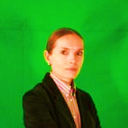
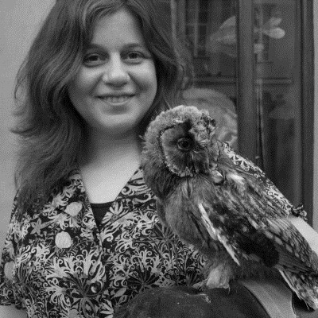
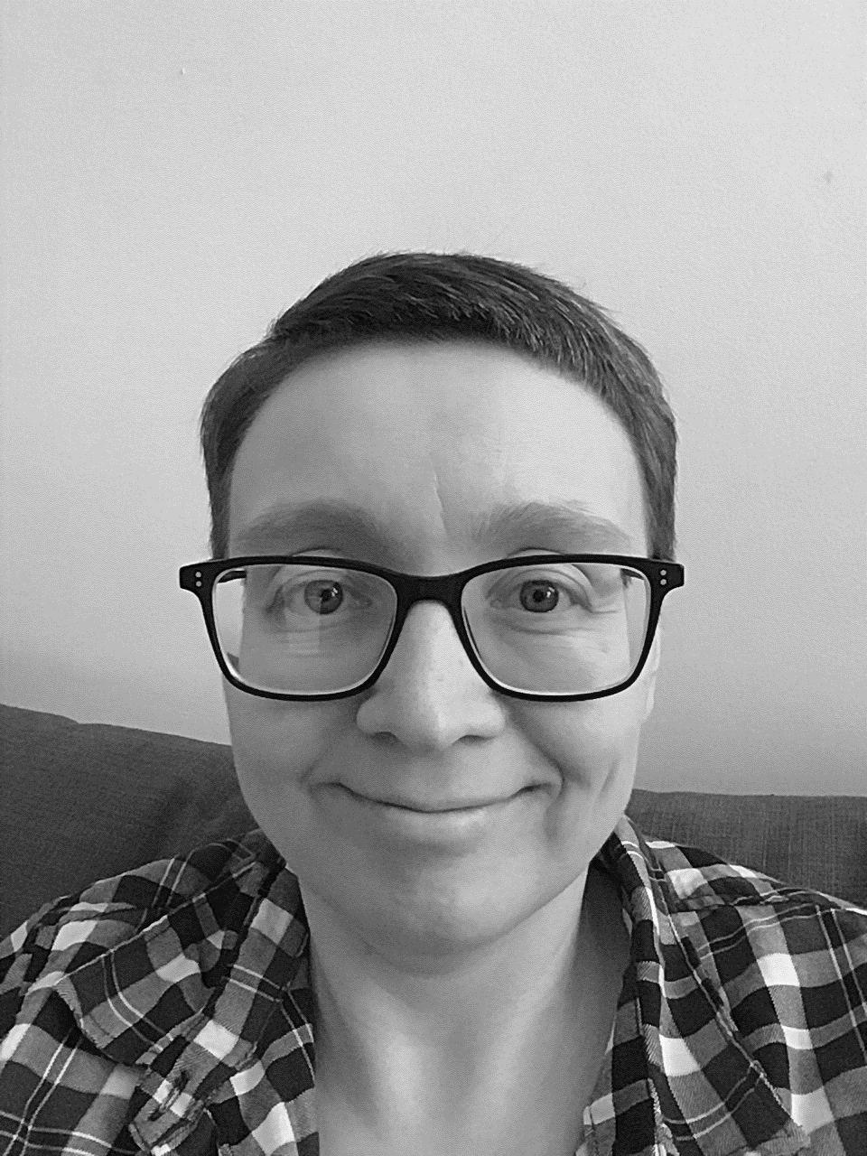
n.kolesnik@socinst.ru
epaneyakh@hse.ru
ykrupets@hse.ru

