Slide 1
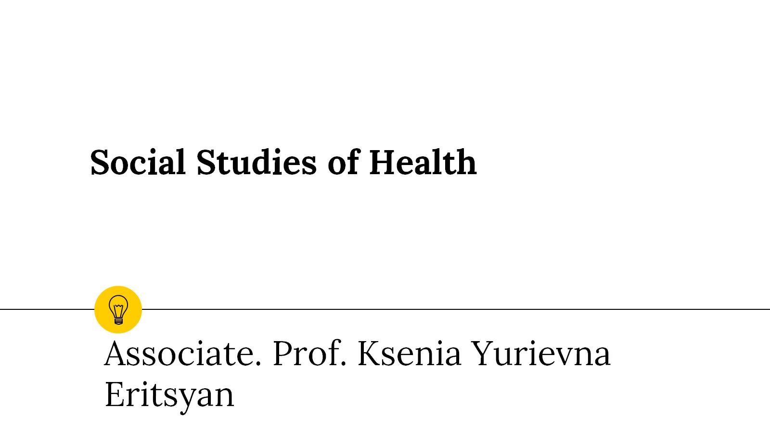
Social Studies of Health

Slide 2
Which health messages are more effective

Slide 3
Which health messages are more effective

Slide 5
All this we are going to study in this super interdisciplinary course

Slide 6
And project management ☺

Slide 7
What we are going to study?

Slide 8
What we are going to study?

Slide 9
What we are going to study?

Slide 10
How we’re going to study?

Slide 11
And please note that health is

Slide 12
See you!

