Slide 1
Социальные алгоритмы: направления развития
Библиографический обзор
Илья Мусабиров Денис Булыгин
Supported by the Academic Fund Program at the National Research University Higher School of Economics (HSE) in 2017-2018 (grant # 17-05-0024) and by the Russian Academic Excellence Project "5-100"

Slide 2
Данные
База публикаций Scopus (включает основные CS конференции помимо журналов)
Запрос: Algorithm* AND social AND user AND experience
721 документ

Slide 3
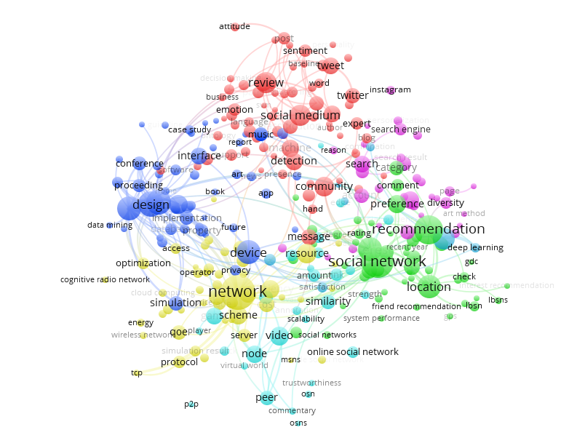
Keywords and abstracts (Full)
Notes:
Algorithm* AND social AND user experience

Slide 4
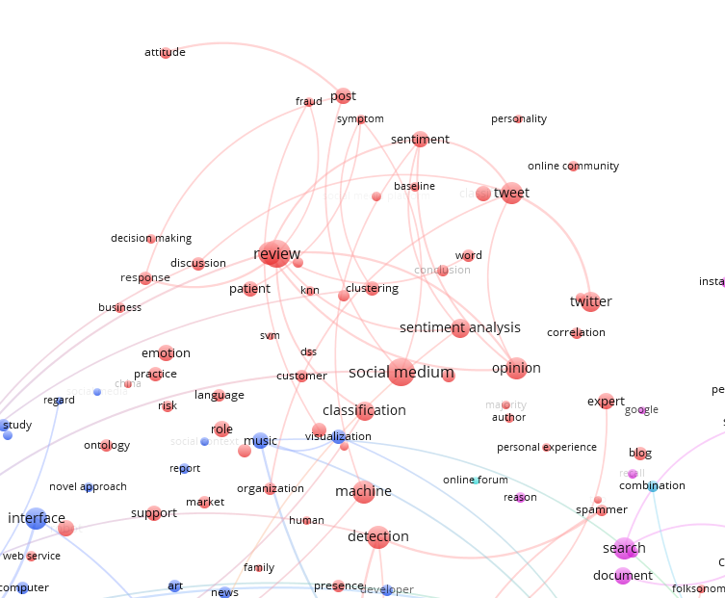
Computational methods

Slide 5
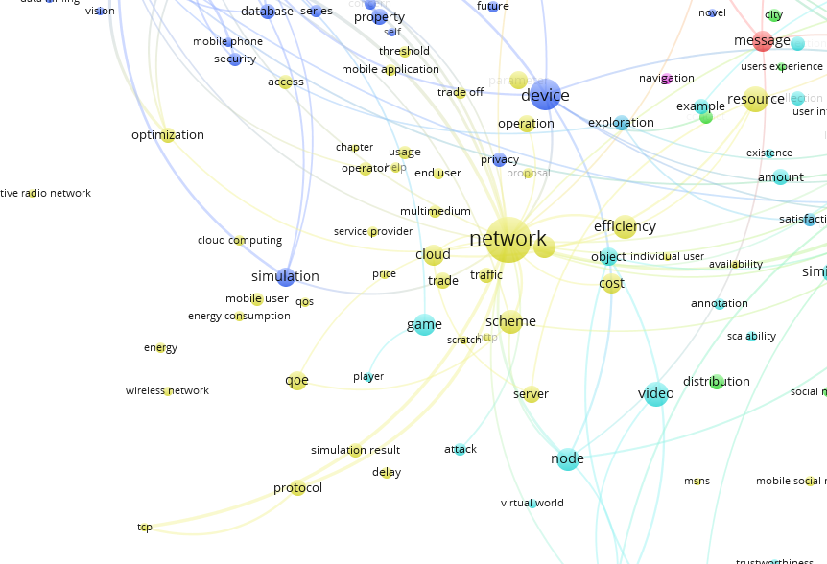
Cloud computing
Network architecture

Slide 6
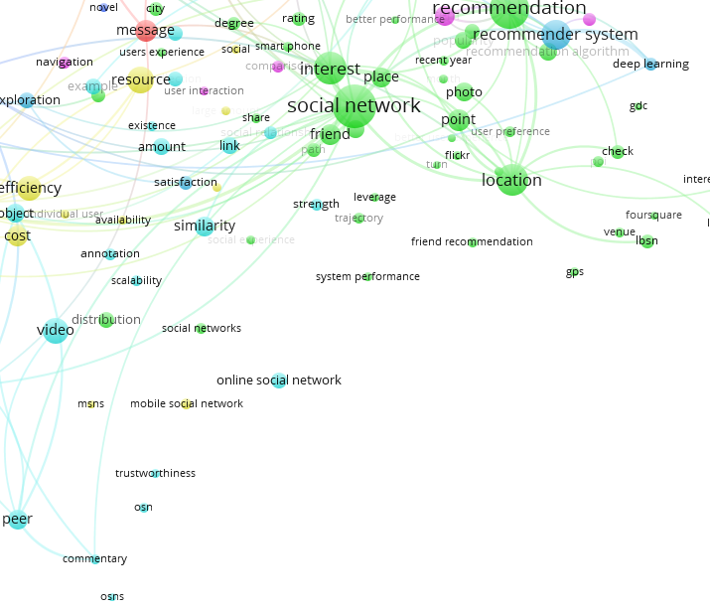
Recommendation systems

Slide 7
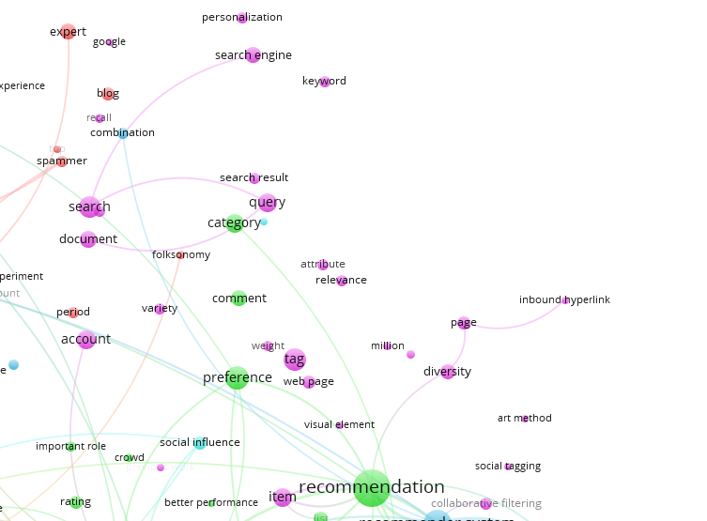
Search enquiry algorithms

Slide 8
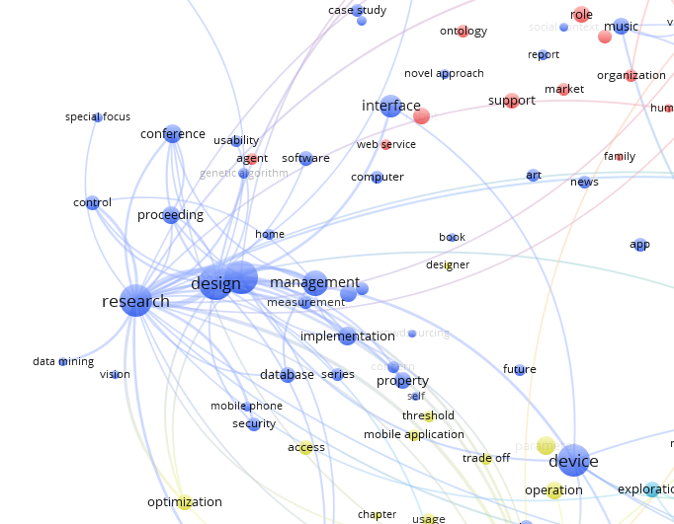
General markers of (HCI/IR) publications

Slide 9
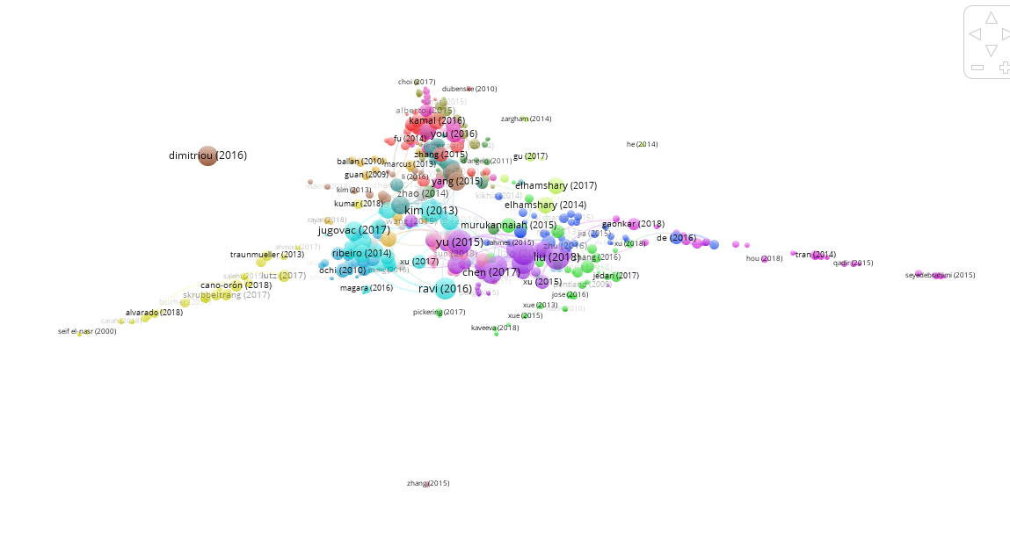
Computational methods
Social media and awareness
Trust
Recommendations
Tagging
Ranking
Text-mining
Spatial recommendations
Notes:
Bib coup docs

Slide 10
Computational Methods
A Personalized Recommender System using Machine Learning based Sentiment Analysis over Social Data (2016)
... In this paper, we propose a such a social framework, which extracts user’s reviews, comments of restaurants and points of interest such as events and locations, to personalize and rank suggestions based on user preferences. Machine Learning and Sentiment Analysis based techniques are used for further optimizing search query results…
HyRA: A Hybrid Recommendation Algorithm Focused on Smart POI. Ceutí as a Study Scenario (2018)
...Nowadays, Physical Web together with the increase in the use of mobile devices, Global Positioning System (GPS), and Social Networking Sites (SNS) have caused users to share enriched information on the Web such as their tourist experiences. Therefore, an area that has been significantly improved by using the contextual information provided by these technologies is tourism… Hence, a novel Hybrid Recommendation Algorithm (HyRA) is presented by incorporating an aggregation operator into the user-based Collaborative Filtering (CF) algorithm as well as including the Smart POIs’ categories and geographical information...

Slide 11
Social Media and awareness
#RIPINSTAGRAM: Examining user’s counter-narratives opposing the introduction of algorithmic personalization on Instagram (2017)
...In this paper, we examine how users commented on the announcement of Instagram implementing algorithmic personalization… Qualitative analysis resulted in the identification of the following four counter-narratives brought forth by users: 1) algorithmic hegemony; 2) violation of user autonomy; 3) prevalence of commercial interests; and 4) deification of mainstream...
Online Serendipity: A Contextual Differentiation of Antecedents and Outcomes (2017)
...Critics worry that algorithmic filtering could lead to overly polished, homogeneous web experiences...We propose a nomological model of online serendipity experiences, conceptualizing both cognitive and behavioral antecedents...We conduct structural equation modeling and multigroup analyses to differentiate the antecedents and effects of serendipity across three distinct contexts: online shopping, information services, and social networking sites...

Slide 12
Trust
Understanding Graph-based Trust Evaluation in Online Social Networks: Methodologies and Challenges (2016)
...Online social networks (OSNs) are becoming a popular method of meeting people and keeping in touch with friends. OSNs resort to trust evaluation models and algorithms, as to improve service qualities and enhance user experiences… Graph-based approaches make up a major portion of the existing works, in which the trust value is calculated through a trusted graph...We first summarize the features of OSNs and the properties of trust. Then, we comparatively review two categories of graph-simplification based and graph-analogy based approaches, and discuss their individual problems and challenges. We also analyze the common challenges of all graph-based models...
Research on Trust Prediction from a Sociological Perspective (2015)
...Trust, as a major part of human interactions, plays an important role in helping users collect reliable information and make decisions… In this paper, we investigate how to exploit homophily and social status in trust prediction by modeling social theories… Experimental results on real-world datasets demonstrate the effectiveness of the proposed framework...

Slide 13
Recommendations
Exploring social tagging for personalized community recommendations (2013)
...In this study we focus on the issue of recommending social communities (or groups) to individual users. We address specifically the potential of social tagging for accentuating users’ interests and characterizing communities. We also discuss some unique methods of improving several techniques that have been adapted for use in the context of community recommendations: collaborative filtering, a random walk model, a Katz influence model, a latent semantic model, and a user-centric tag model...
Interacting with Recommenders — Overview and Research Directions (2017)
...Automated recommendations have become a ubiquitous part of today’s online user experience… In many of today’s applications, however, the only way for users to interact with the system is to inspect the recommended items. Often, no mechanisms are implemented for users to give the system feedback on the recommendations or to explicitly specify preferences, which can limit the potential overall value of the system for its users… This work provides a comprehensive overview on the existing literature on user interaction aspects in recommender systems...Throughout the work, we furthermore discuss examples of real-world systems and outline possible directions for future works...

Slide 14
Tagging
Personalized Tag Recommendation Using Graph-based Ranking on Multi-type Interrelated Objects (2009)
...A tag recommendation module can assist users in tagging process by suggesting relevant tags to them… We address the problem of personalized tag recommendation for text documents. In particular, we model personalized tag recommendation as a "query and ranking" problem and propose a novel graph-based ranking algorithm for interrelated multi-type objects… Experiments on a large-scale tagging data set collected from Del.icio.us have demonstrated that our proposed algorithm significantly outperforms algorithms which fail to consider the diversity of different users' interests...
Web Experience Enhancer Based on a Fast Hierarchical Document Clustering Approach (2014)
...The amount of sheer information that can be obtained from this global information service center leads to major challenges concerning finding relevant information for a casual user or a group of users… We propose an application...that can help the user keep track of his web experience in a highly organized and easy to navigate fashion while also enabling the user to share some of that experience. The clustering of the data is done with a customized algorithm that allows overlapping while showing improved speed and readability...

Slide 15
Rankings
ExpertRank: An Expert User Ranking Algorithm in Online Communities (2009)
...One important research issue in online communities is how to find expert users in the community. In this paper, we investigate the expertise that users displayed in online communities, especially in discussion groups and propose an effective expert ranking algorithm, which integrates both discussion thread contents and social network extracted from massive social interactions. We present a vector space model to compute the content relevance part and a PageRank style algorithm for the expert network part…
Diversity between Human Behaviors and Metadata Analysis: A Measurement of Mobile App Recommendation (2013)
...We propose a novel recommending method by utilizing the global information of apps. To be specific, we leverage the Latent Semantic Indexing method to analyze the metadata of apps, which is globally held by the [google play] market… To further understand both the human behavior based and the metadata analysis based methods, we then measure the diversity within them from multiple levels and scopes. Through such measurements, we eventually discover new knowledge of user preferences and gain better understanding of both recommending methods...

Slide 16
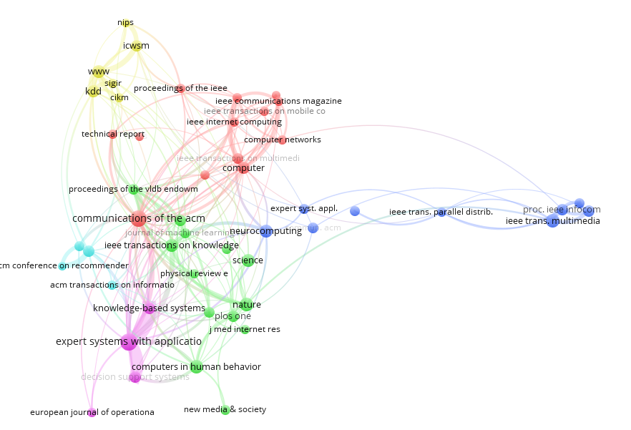
Co-citation resources
Notes:
Cocit sources

Slide 17
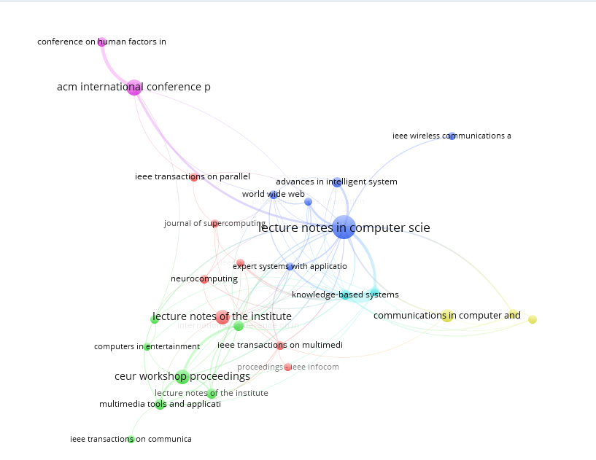
Bib coupling resources
Notes:
Bib coup sources

Slide 18
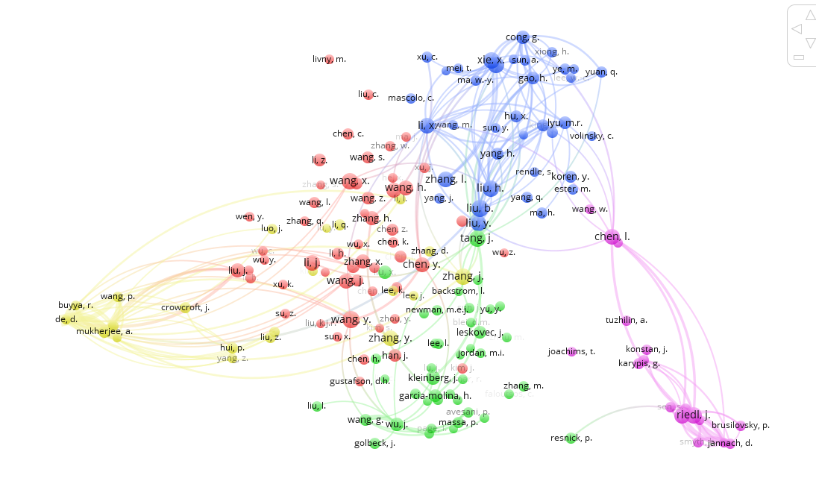
Co-citation authors
Notes:
Cocit authors

Slide 19
Заключение и планы
Тема социальных алгоритмов активно развивается, захватывая разные подобласти (не концентрируется в рамках одного строгого направления)
Много работ за 2017 и 2018 год
Включает более старые области (например, рейтинги и тегирование), которые нельзя исключать из рассмотрения Что дальше? Анализировать каждый кластер более глубоко
Искать точки пересечения
Фокус на работах про интерпретацию алгоритмов

Slide 20
Список литературы
Ashok, Meghana, Swathi Rajanna, Pradnyesh Vineet Joshi, and Sowmya Kamath. "A personalized recommender system using Machine Learning based Sentiment Analysis over social data." In Electrical, Electronics and Computer Science (SCEECS), 2016 IEEE Students' Conference on, pp. 1-6. IEEE, 2016.
Alvarado-Uribe, Joanna, Andrea Gómez-Oliva, Ari Yair Barrera-Animas, Germán Molina, Miguel Gonzalez-Mendoza, María Concepción Parra-Meroño, and Antonio J. Jara. "HyRA: A Hybrid Recommendation Algorithm Focused on Smart POI. Ceutí as a Study Scenario." Sensors 18, no. 3 (2018): 890.
Skrubbeltrang, Martina Mahnke, Josefine Grunnet, and Nicolai Traasdahl Tarp. "# RIPINSTAGRAM: Examining user’s counter-narratives opposing the introduction of algorithmic personalization on Instagram." First Monday 22, no. 4 (2017).
Lutz, Christoph, Christian Pieter Hoffmann, and Miriam Meckel. "Online serendipity: A contextual differentiation of antecedents and outcomes." Journal of the Association for Information Science and Technology 68, no. 7 (2017): 1698-1710.
Jiang, Wenjun, Guojun Wang, Md Zakirul Alam Bhuiyan, and Jie Wu. "Understanding graph-based trust evaluation in online social networks: Methodologies and challenges." ACM Computing Surveys (CSUR) 49, no. 1 (2016): 10.
Wang, Ying, Xin Wang, and Wan-Li Zuo. "Research on trust prediction from a sociological perspective." Journal of Computer Science and Technology 30, no. 4 (2015): 843-858.
Kim, Heung-Nam, and Abdulmotaleb El Saddik. "Exploring social tagging for personalized community recommendations." User Modeling and User-Adapted Interaction 23, no. 2-3 (2013): 249-285.
Jugovac, Michael, and Dietmar Jannach. "Interacting with recommenders—overview and research directions." ACM Transactions on Interactive Intelligent Systems (TiiS) 7, no. 3 (2017): 10.
Guan, Ziyu, Jiajun Bu, Qiaozhu Mei, Chun Chen, and Can Wang. "Personalized tag recommendation using graph-based ranking on multi-type interrelated objects." In Proceedings of the 32nd international ACM SIGIR conference on Research and development in information retrieval, pp. 540-547. ACM, 2009.
Dospinescu, Alexandru Ionut, Florin Pop, and Valentin Cristea. "Web Experience Enhancer Based on a Fast Hierarchical Document Clustering Approach."
Jiao, Jian, Jun Yan, Haibei Zhao, and Weiguo Fan. "Expertrank: An expert user ranking algorithm in online communities." In New Trends in Information and Service Science, 2009. NISS'09. International Conference on, pp. 674-679. IEEE, 2009.
Xia, Xiao, Xiaodong Wang, and Xingming Zhou. "Diversity between human behaviors and metadata analysis: a measurement of mobile app recommendation." In International Conference on Wireless Algorithms, Systems, and Applications, pp. 300-312. Springer, Berlin, Heidelberg, 2013.

