Slide 1
HSE UNIVERSITY
ST. PETERSBURG
Department of History
and Center for Historical Research
http://sh.spb.hse.ru/en/history/

Slide 2
i

Slide 3
Federal Universities
Since 2006
Mission: enhancement of regional education and development of professional links with economics and social sphere of the Federal Districts (10 Universities)
CLUSTERS OF TOP RUSSIAN UNIVERSITIES
National Research Universities
Since 2009
Mission: enhance learning process through adoption of research lead teaching
(29 Universities, including HSE)
Since 2012
Russian Academic Excellence Project
Mission: to maximize the competitive position of a group of leading Russian universities in the global research and education market. The ‘5-100’ project
(15 universities, including HSE)
HIGHER SCHOOL OF ECONOMICS is the only university in the fields of Social Sciences and Humanities which is both a National Research University and a university within the 5-100 Project
HSE UNIVERSITY ST. PETERSBURG | 4

Slide 4
DEPARTMENT OF HISTORY:
FACTS AND FIGURES
Created in 2012
Bachelor of Arts in History degree program cа. 176 students
International Master Program in Applied and Interdisciplinary History “Usable Pasts” ca. 40 students
Ph.D. program: 3 places each year
Center for Historical Research (projects include faculty and students)
International Research Project “Comparative Historical Studies of Empire and Nationalism” co-directed by Professor Ronald Suny (University of Michigan, USA; HSE – Saint-Petersburg) and Professor Alexander Semyonov (HSE – Saint-Petersburg)
Partnership with DAAD
International regular research seminar “Boundaries of History”
INTERNATIONAL SUMMER SCHOOLS
HSE UNIVERSITY ST. PETERSBURG | 5

Slide 5
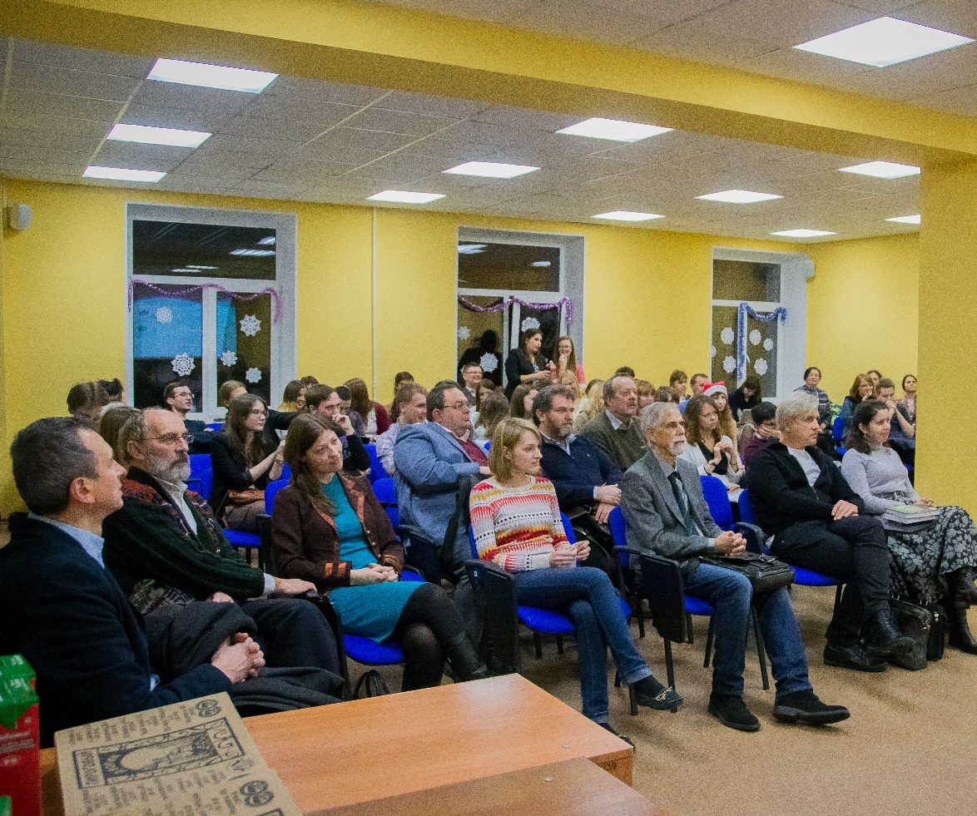
MISSION OF THE DEPARTMENT
Systematic development of the field of global, comparative, and transnational history as a potent tool of overcoming the limitations of national history canon;
Fostering interdisciplinary dialogue in the field of social sciences and humanities;
Brining new public relevance to historical knowledge;
Developing new type of historical undergraduate and graduate education in Russia;
Pioneering new research fields in Russian historiography in dialogue with the global historical scholarship;
INTERNATIONAL SUMMER SCHOOLS
HSE UNIVERSITY ST. PETERSBURG | 6

Slide 6
AREAS OF EXCELLENCE IN RESEARCH AND TEACHING
AREAS OF EXCELLENCE IN RESEARCH AND TEACHING
Comparative history of empire, colonialism, and nationalism;
Environmental and technological history;
Social and cultural history of borders and borderlands;
Intellectual history and history of science;
History and anthropology of religion;
Historical Geography, digital humanities, and GIS.
REGIONS OF STRONG EXPERTISE
Northern Europe, Baltics
Siberia and the Circumpolar North
Germany and Central Europe
Eastern Europe, Russia/Eurasia
Far East, East Asia, and the Pacific
INTERNATIONAL SUMMER SCHOOLS
HSE UNIVERSITY ST. PETERSBURG | 7

Slide 7
COMPARATIVE HISTORY OF EMPIRE, COLONIALISM, AND NATIONALISM
Ronald G. Suny (University of Michigan), Alexander Semyonov,
Ivan Sablin, Anton Kotenko, Jeremy Smith (University of Eastern Finland) Sergey Glebov (Amherst College)
Research projects:
«Comparative Historical Studies of Empire and Nationalism»
«Territorialization of ruling regimes of diversity: inner and outer borders in the Russian history»
«Construction of political space in historical empires: comparative historical analysis»,
Foci of research:
nationalism as a political force emanating from imperial context;
ideological foundations of imperial rule and nationalist politics in comparative perspective;
territorialization of imperial governance in the Russian Empire and Soviet Union;
constitutionalism, autonomism, federalism, and the minority rights in empire and nation-states.
Publication Highlight:
2016 - Book series with Routledge (category B by SENSE ranking of scientific publishers) «Imperial Transformations: Russian, Soviet and Post-Soviet History».
INTERNATIONAL SUMMER SCHOOLS
HSE UNIVERSITY ST. PETERSBURG | 8

Slide 8
ENVIRONMENTAL AND TECHNOLOGICAL HISTORY, AND
HISTORY OF SCIENCE
Julia Lajus, Alexandra Bekasova, Margarita Dadykina, Marina Loskutova , Elena Kochetkova
Research projects:
“New governance for sustainable development of the European Arctic” and “Between Science and Politics: How Arctic Research Survived and Thrived in the Cold War – and Beyond” – in cooperation with Royal Institute of Technology, Stockholm, Sweden, 2014 – 2017.
Exploring Russia’s Environmental History” Leverhulme Trust, UK, 2013 – 2016.
History of Oceans, COST project 2014 – 2018.
“Moving of the material in history: the role of natural resource, materials and goods in institutional and infrastructural development (HSE funded project)
Research areas and foci – history of
resource use, mainly marine, mineral and forest resources;
transportation, urban mobilities and tourism;
field sciences, especially in the Arctic;
history of water;
Soviet technological projects in the Third World, mainly Africa.
Publications: special issues of Journal of Historical Geography, SEER, forthcoming papers in Technology and History, Journal of Tourism Studies, book projects with Oxford University Press and other leading publishers (chapters in books – env. history of BRICS countries, Arctic history), volume on history of science and technology during the First World War (J.Lajus co-editor), two books on Russian environmental history (Leverhulme funded project)
INTERNATIONAL SUMMER SCHOOLS
HSE UNIVERSITY ST. PETERSBURG | 9

Slide 9
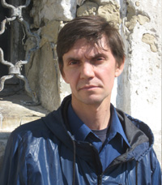
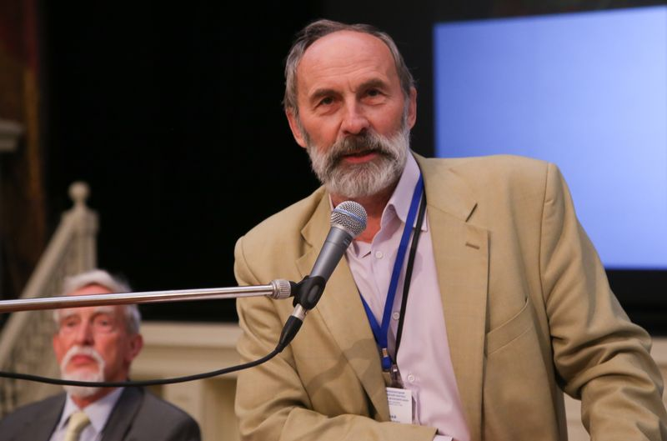
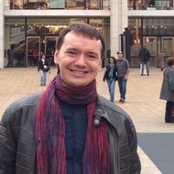
SOCIAL AND CULTURAL HISTORY/HISTORY
OF BORDERS AND BOREDRLANDS
Adrian Selin, Ivan Sablin, Evgenii Anisimov (award of the Russian government in the field of cultural studies)
Research project supported by the Russian Humanities Foundation.
Foci of research:
Borders and borderlands as complex phenomena;
Social and cultural history;
transboundary entanglements and imagined borders
case study: Russian-Swedish border in Ingria (incorporating BA students research project on GIS)
INTERNATIONAL SUMMER SCHOOLS
HSE UNIVERSITY ST. PETERSBURG | 10

Slide 10
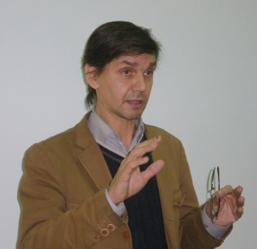
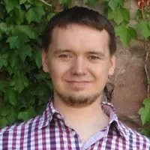
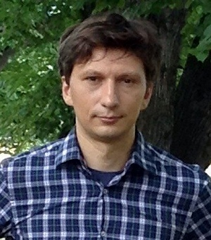
Ivan Sablin, Adrian Selin, Anton Kotenko
HISTORICAL GEOGRAPHY, DIGITAL HUMANITIES AND THE GIS
Combines research and teaching methodologies in digital humanities, specifically digital history;
develops GIS and other historical databases as part of BA and MA curricula;
runs an Applied GIS in Humanities research/study group jointly between the Department of History (HSE Saint Petersburg) and the Department of Linguistics (HSE Moscow) and published a GIS on linguistic, social and religious composition of the population of the Russian Empire and the early Soviet Union.
INTERNATIONAL SUMMER SCHOOLS
HSE UNIVERSITY ST. PETERSBURG | 11

Slide 11
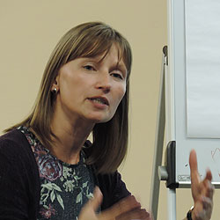
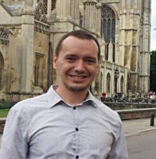
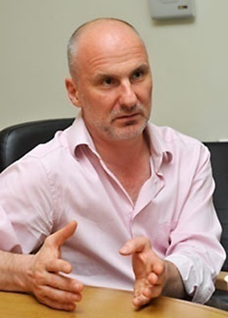
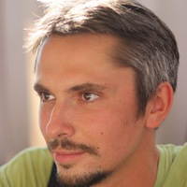
Zhanna Kormina, Ivan Sablin, Nikolai Ssorin-Chaikov, Evgeny Khvalkov
HISTORTY AND ANTHROPOLOGY OF RELIGION
Goals of research:
To explore the reassertion of religion in new cultural forms and historical dynamics;
to theorise the “post-secular” (Habermas) combining anthropological and historical research methods that include fieldwork and collection of oral-historical and archival materials
Foci of research:
Comparative perspective in the history and anthropology of Christianity, Buddhism, shamanism and other religions systems;
in-depth exploration of multiplicity of everyday religious practices, as well as of boundaries of secularisms and religiosities.
INTERNATIONAL SUMMER SCHOOLS
HSE UNIVERSITY ST. PETERSBURG | 12

Slide 12
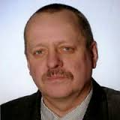
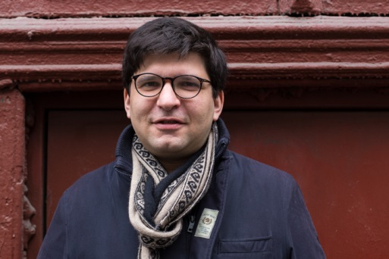
GERMANY AND CENTRAL EUROPE
Partnership with DAAD – The German Academic Exchange Service) - a long-term associate professorship at the HSE department of History in St. Petersburg in May 2014. Dr. Dietmar Wulff (Bielefeld University, Voronezh State University, HSE – Saint-Petersburg).
German and Central European history is well represented at HSE Saint Petersburg. Three of its faculty members are engaged in teaching and researching the 19th and 20th history of German speaking countries and their relationship with Russia.
Dietmar Wulff, has published widely on German-Russian relations in the 19th and 20th century and organizes the annual DAAD HSE Summer School for German students in Saint-Petersburg.
Alexander Khriakov, who was awarded a university wide teaching prize in 2015, concentrates on German historians and their complex relationship with National socialism.
Nathan Marcus is an economic historian with a forth-coming book on Austrian history of the 1920s (HUP 2016). His next project compares the German and Austrian currency reforms that followed upon WWII.
INTERNATIONAL SUMMER SCHOOLS
HSE UNIVERSITY ST. PETERSBURG | 13

Slide 13
GRADUATES OF THE HISTORY
UNDERGRADUATE PROGRAM TODAY
Courses in Russian and English in all time periods and areas of Russian and World History
216 students
Student research supervised by established scholars from the Department
Archeological, museum, and archival internships
Annual international summer/winter schools in English
Student exchange with HSE Moscow
Vibrant student life in the cultural capital of Russia
HSE UNIVERSITY ST. PETERSBURG | 14

Slide 14
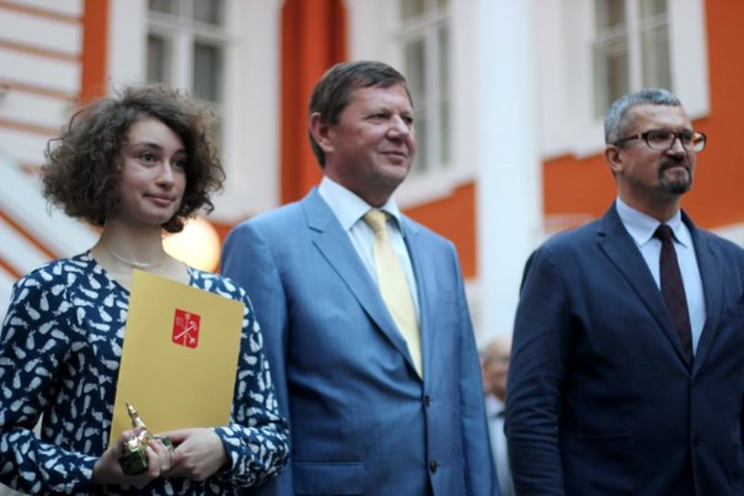
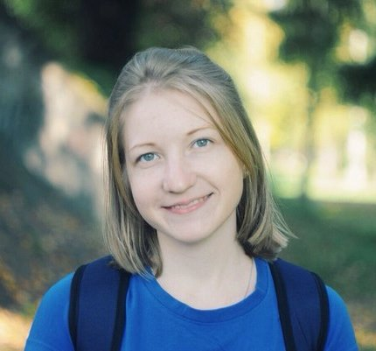
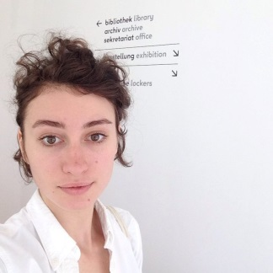
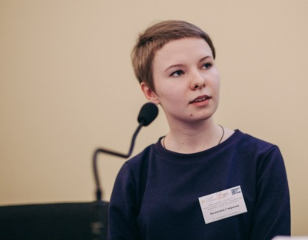
UNDERGRADUATE PROGRAM IN HISTORY
60% of graduates continued their studies in MA programs
30% of graduates were admitted with full scholarship to top international MA programs in history:
Kseniya Litvinenko,
Anna Smelova,
Valentina Smirnova
The best graduating student of HSE University in St. Petersburg of 2016: Ksenia Litvinenko
HSE UNIVERSITY ST. PETERSBURG | 15

Slide 15
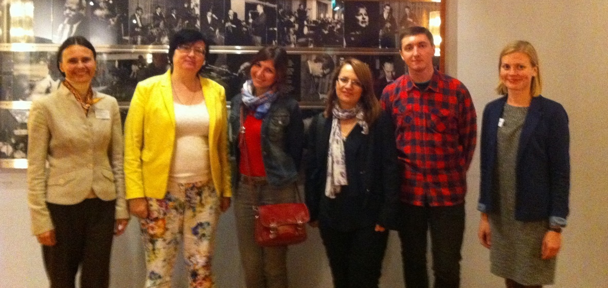
INTERNATIONAL MASTER’S PROGRAM
APPLIED AND INTERDISCIPLINARY HISTORY “USABLE PASTS”
Opened in 2015
Language of instruction – English
Length of study - 2 years
Total number of credits - 120 ECTS
Number of students: 15 Russian, 8 international
Key Program Features
Unique combination of academic and professional training
Interdisciplinary approach – admission of students with a background in any academic discipline
Special emphasis on the practical use of historical knowledge through focusing on research work and practically oriented MA theses
Internships and projects in order to obtain cross-cultural skills
Active learning methods - case studies, research seminars, master classes and internships
Focus on digital humanities in teaching and research using modern IT
Partnership with University of Jyväskylä (Finland) Student exchange (One semester abroad) + Intensive joint course
INTERNATIONAL SUMMER SCHOOLS
HSE UNIVERSITY ST. PETERSBURG | 16

Slide 16
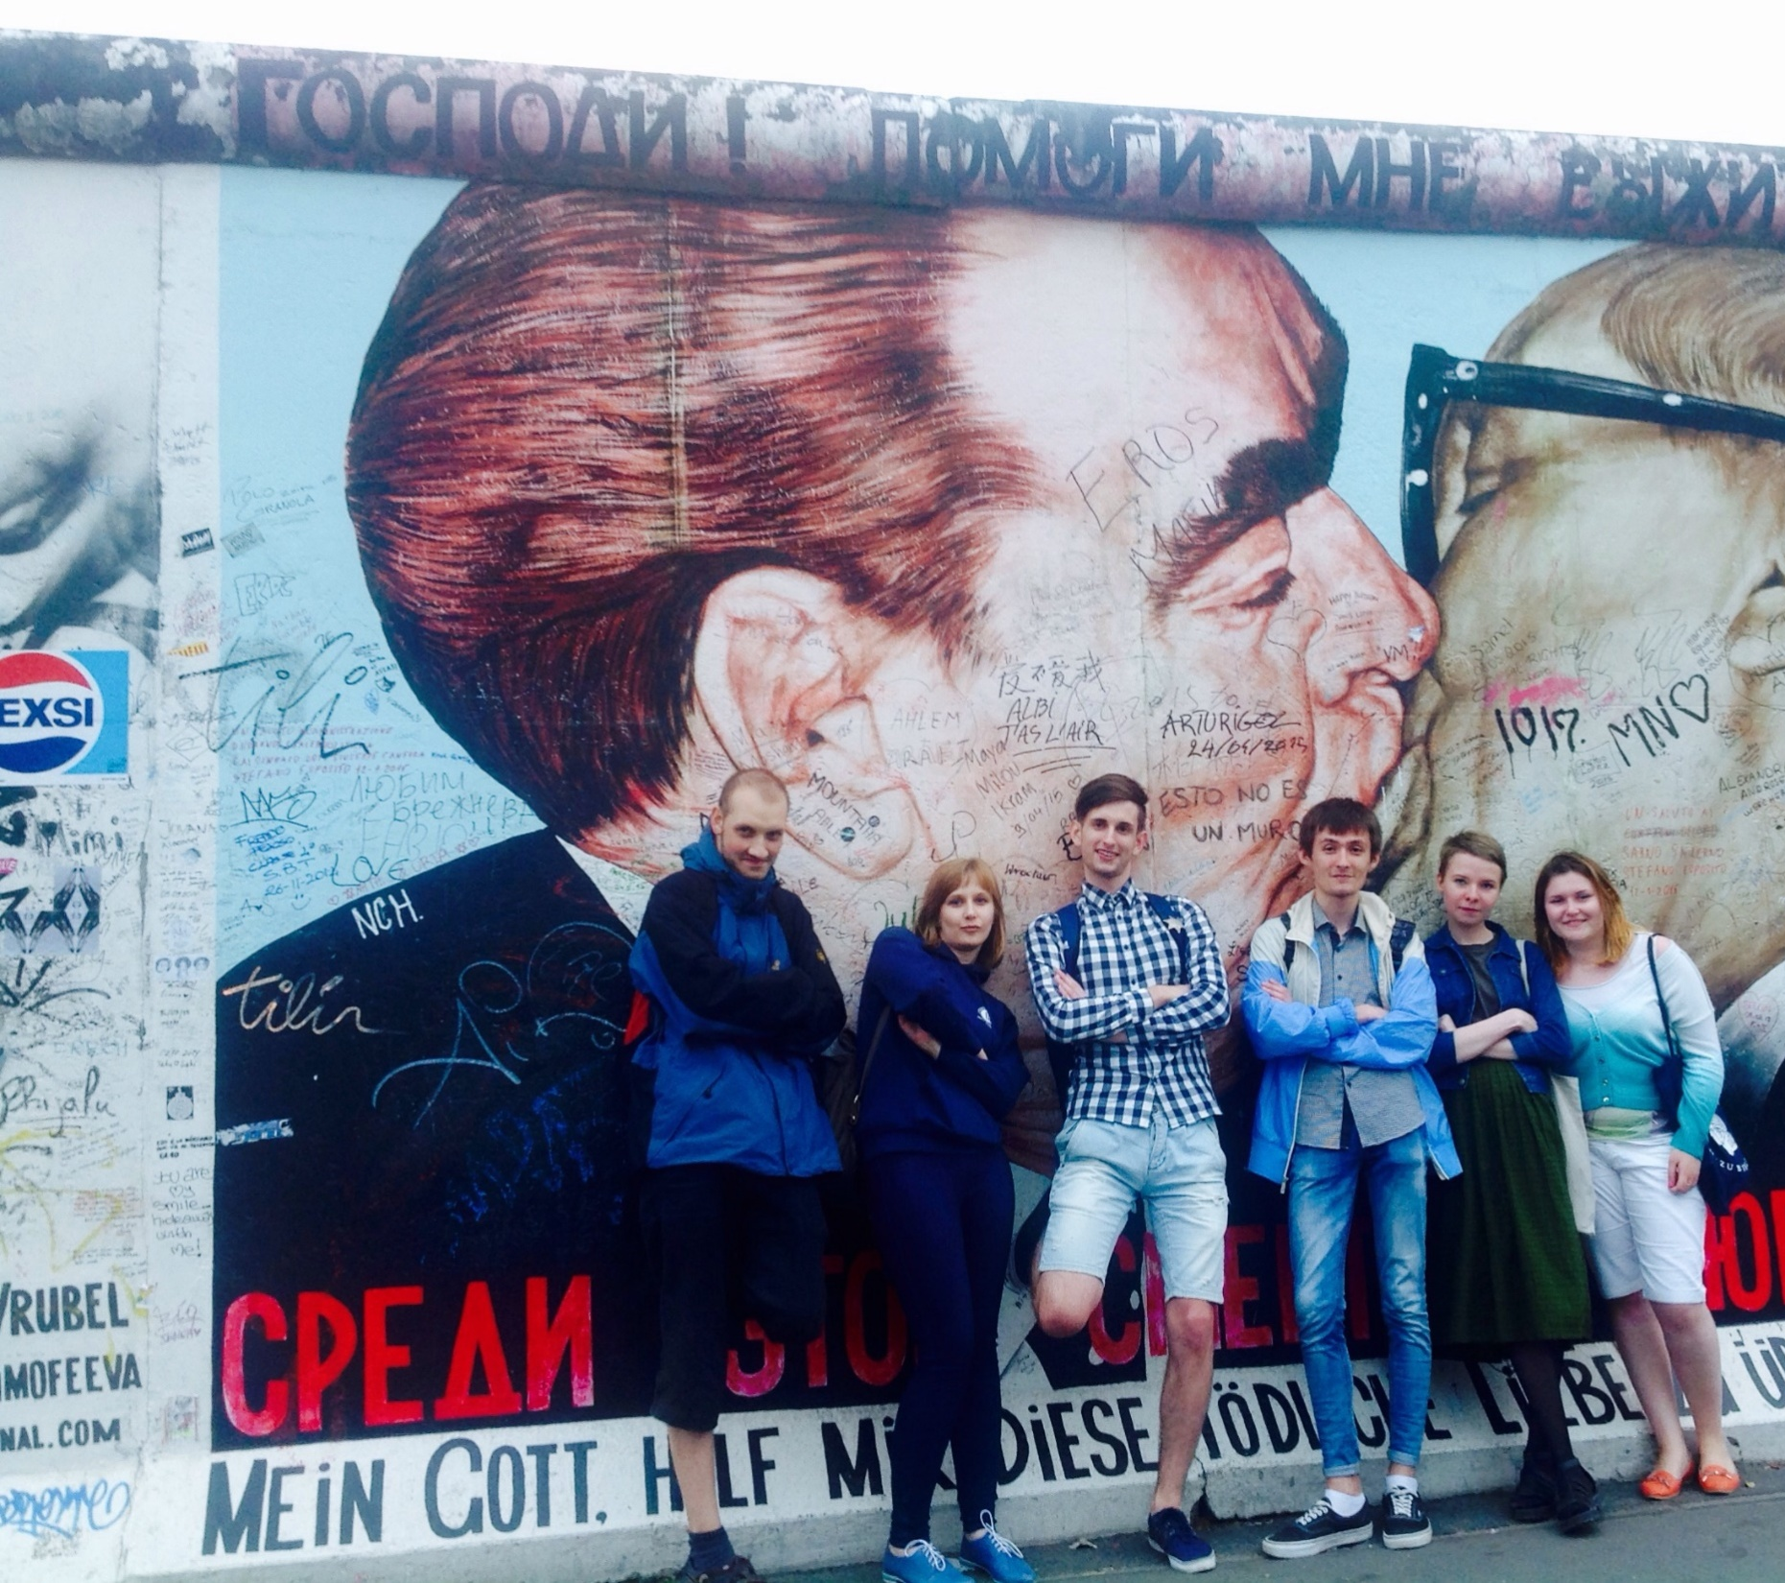
INTERNATIONAL MASTER’S PROGRAM
APPLIED AND INTERDISCIPLINARY HISTORY “USABLE PASTS”
3 focus areas:
Historical memory and historically informed discourses of public politics and identity politics, nationalism, cultural heritage and nationalization of the past, symbolic representations of history in post-imperial and post-colonial societies, studies of collective trauma and historical justice.
Historical training with the main focus on historical, cultural, and natural heritage, including public museums and media space; archeology and policy of historical heritage, environmental history, history of science, technological history, urban history, economic history, history and law.
Methodology of interdisciplinary history and applied historical methods including but not limited to material culture, digital humanities, oral history, database management, historical- geographic information systems and visualization methods
INTERNATIONAL SUMMER SCHOOLS
HSE UNIVERSITY ST. PETERSBURG | 12

Slide 17
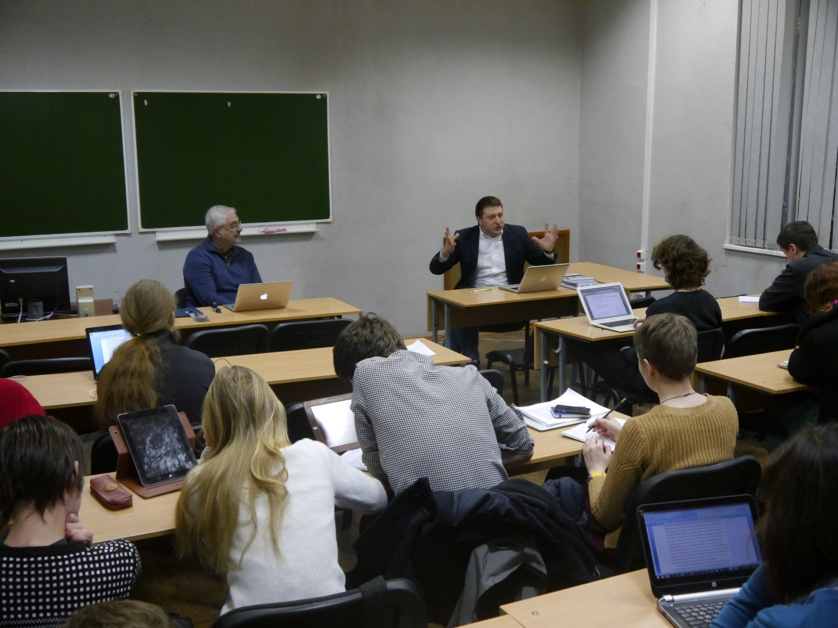
PH.D. PROGRAM
IN HISTORY
Postgraduate School in History was opened in 2013.
Postgraduate students are involved into the projects of the Center for Historical Research
Master classes and seminars with leading historians for postgraduate students
HSE UNIVERSITY ST. PETERSBURG | 18

Slide 18
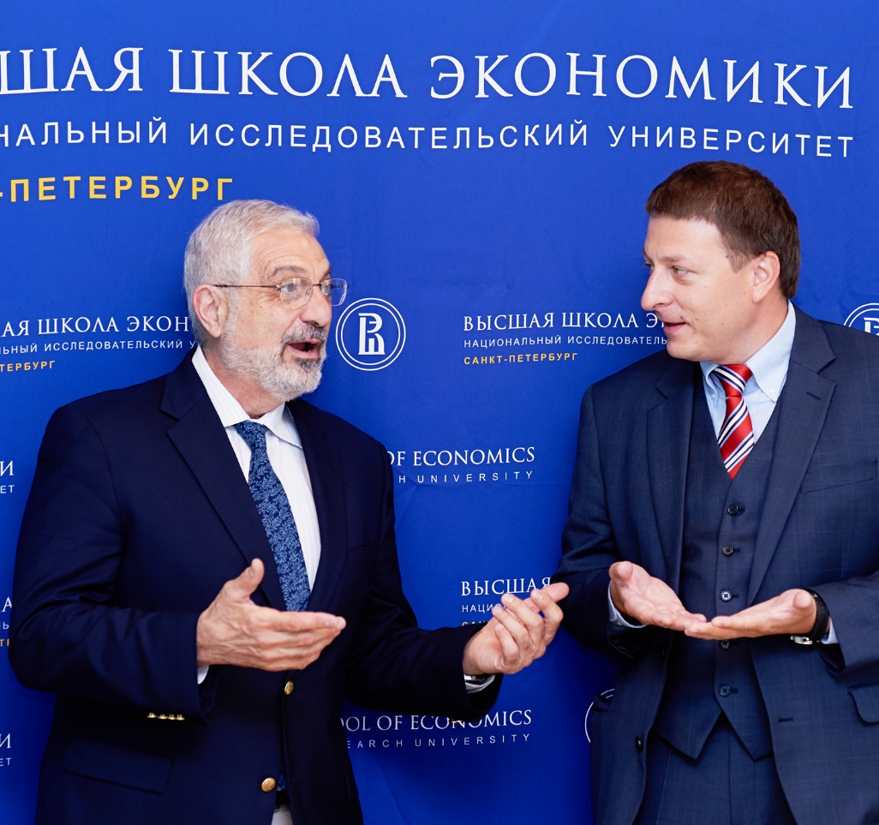
RESEARCH
Research Seminar «Boundaries of History»
Center for Historical Research (Alexander Semyonov)
Projects: «History of technologies and infrastructure systems in Russia and the USSR: standardization processes and practices and its participants», «Historical problems of the Russian technological modernization»
International Research Project «Comparative Historical Studies of Empire and Nationalism»;
Applied GIS in Humanities (student research group). Fields of scientific research of the group: geoinformatics, history, linguistics;
Conferences, Summer Schools
HSE UNIVERSITY ST. PETERSBURG | 19

Slide 19
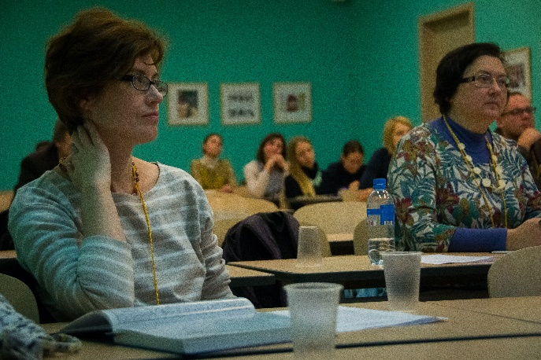
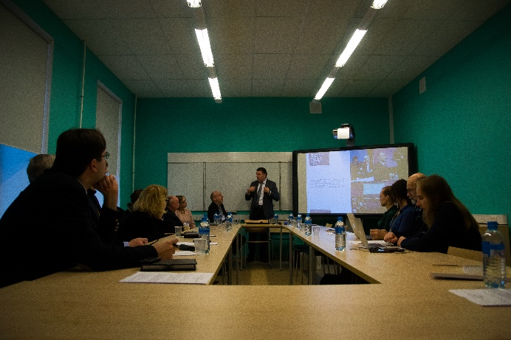
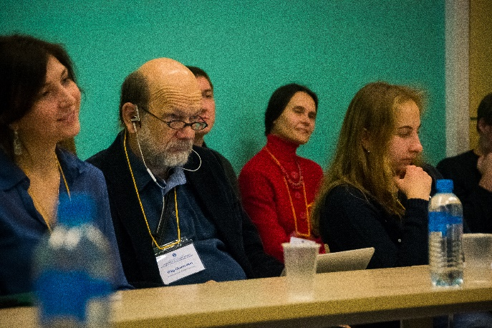
RESEARCH
Research Seminar «Boundaries of History»
Chair of the Research Seminar: Alexander Semyonov
The department hosts the regular research seminar «Boundaries of History» chaired by Professor Alexander Semyonov. The potent metaphor of boundaries is deployed in the title of the seminar to highlight its permanent discussion threads:
1) Opportunities and potentialities of historical research across the boundaries of national history and beyond the research agenda of national historiographic canon;
2) the porous boundaries between the discipline of history and adjacent fields of social sciences and potentialities of the cross-disciplinary research agenda setting;
3) the imagined boundary between the past and the present and the relevance of historical knowledge for contemporary and future-oriented public and expert debate in modern societies;
4) the boundary between professional history and lay and public history. This seminar series comprises sessions with pre-circulated research papers both in English and Russian as well as public lectures and debates.
HSE UNIVERSITY ST. PETERSBURG | 20

Slide 20
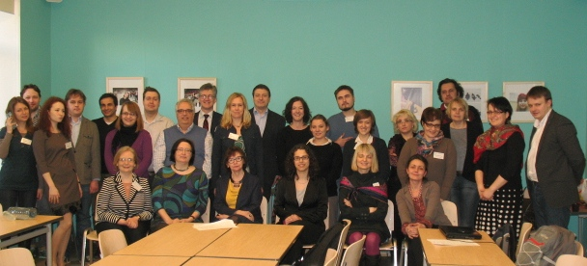
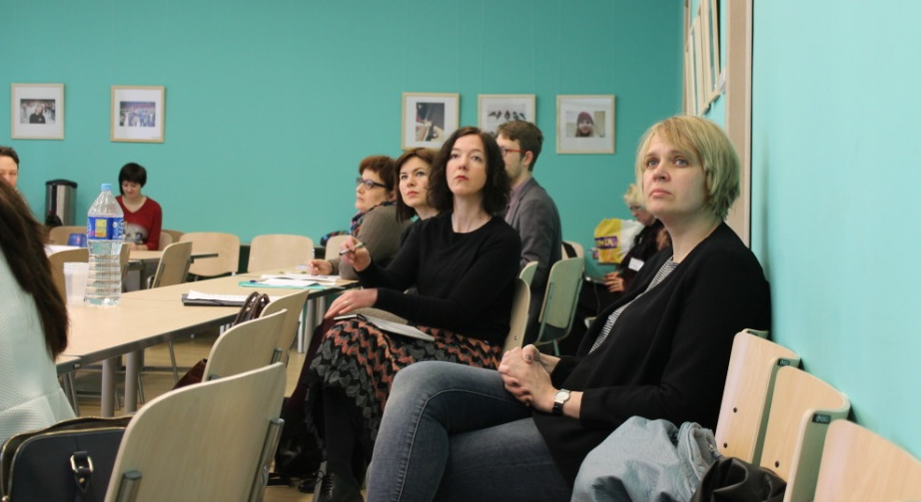
CENTER FOR HISTORICAL RESEARCH
Foci of research:
Early Modern, Modern and Contemporary History
Cross-disciplinary connections in historical research
Research projects are in the following fields:
Comparative studies of Empire, Nationalism, and Colonialism;
Environmental history and history of technology and mobility;
History of Construction of Political Borders Boundaries, Cultural Boundaries, and Contact Zones;
Intellectual history and political theory.
The Center for provides a platform for bridging research and education in the department of history and for involvement of undergraduate, graduate and postgraduate students in historical research.
HSE UNIVERSITY ST. PETERSBURG | 21

Slide 21
CENTER FOR HISTORICAL RESEARCH
Center for Historical Research and Department of History participate in the project «Exploring Russia's Environmental History and Natural Resources» (2013-2016), supported by the Leverhulme International Network grant.
This project unites the leading research centers of the UK, the USA and Russia, that focus on studying Russia’s environmental history (the York University, Georgetown University, University of Glasgow, the Ohio State University, European University at Saint-Petersburg and HSE – Saint-Petersburg). Head of the project – Professor David Moon (the University of York);
Project «Environmental and Technological History of the Russian North and the Arctic within the framework of the international project «New governance for sustainable development in the European Arctic».
HSE UNIVERSITY ST. PETERSBURG | 22

Slide 22
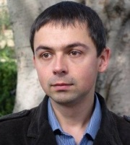
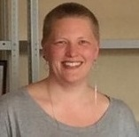
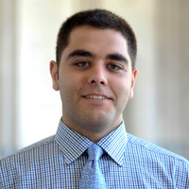
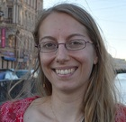
ASSOCIATE RESEARCH FELLOWS
AT THE CENTER FOR HISTORICAL RESEARCH
Andriy Zayarnyuk, University of Winnipeg, Assistant Professor Research project: "Lviv Railway Station in the 20th Century: Social and Cultural History“ (April – March, 2014)
Anna Åberg, Royal Institute of Technology, Research Fellow Research project: "A gap in the Grid: Attempts to establish a Nordic gas grid 1967-1991“ (May – June, 2014)
Stephen Riegg, University of North Carolina, Ph.D. Candidate Research project: "Claiming the Caucasus: The Evolution of Russian Imperialism in Armenia, 1801-1894“ (July – December, 2014)
Sandrine Mayoraz, University of Basel, Ph.D. Candidate Research project: "Jewish workers' riots in the north-western part of the Pale of Settlement between 1881 and 1907“ (July 2014 – January 2015)
HSE UNIVERSITY ST. PETERSBURG | 23

Slide 23
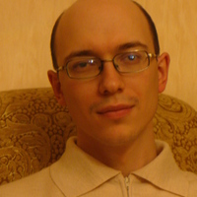
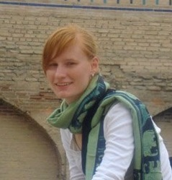
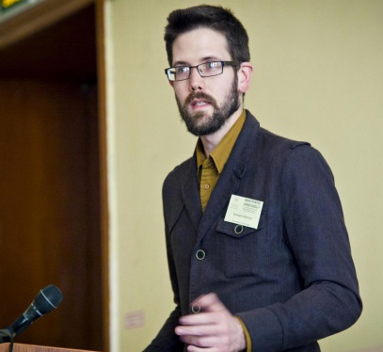
ASSOCIATE RESEARCH FELLOWS
AT THE CENTER FOR HISTORICAL RESEARCH
Andrei Cusco, Al. I . Cuza University of Iasi, Research Fellow
Research project: "Visions and Perceptions of Romania in the Russian Imperial Discourse and Public Sphere in the Late 19th and Early 20th Century”
Kimberly Powers, a postgraduate student from the University of Michigan
Research project: "Mullahs by Appointment, Legitimate Marriages, and Birth Record Books in the Russian Empire”
Brandon Schechter, University of California, Berkeley, Graduate Student
Research project: “The People’s Instructions”: Indigenizing the Great Patriotic War Among “Non-Russians”
HSE UNIVERSITY ST. PETERSBURG | 24

Slide 24
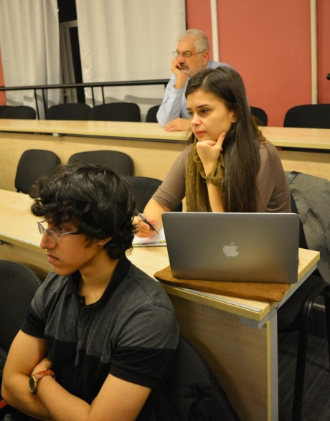
CONFERENCES
June, 4-6, 2015 International conference "Federalism, Regionalism, and Autonomism as Alternative Political Imaginaries of Post-Imperial Political Order“ (International Research Project "Comparative Historical Studies of Empire and Nationalism”)
October, 1- 4, 2014 The first HSE tri-campus history majors conference "From Huge Comparisons to Thick Descriptions: Historical Research and Interpretation"
March, 28−29, 2014
International conference "A Usable Past: Applied and Interdisciplinary
History”
October, 24−25, 2013
International Research Seminar “Historical Biographies in the context of Regional and Imperial borders of Northern Europe”
May, 27−28, 2013
International workshop "When Postcolonial Meets Postimperial: Sovereignty, Politics of Difference, and Composite Society in Comparative Perspectives" - (International research journal “Ab Imperio)
November, 21−22, 2012
International round table "The borders, cross-border communication and mobility in the Baltic region of Europe. Past and Present”
HSE UNIVERSITY ST. PETERSBURG | 25

Slide 25
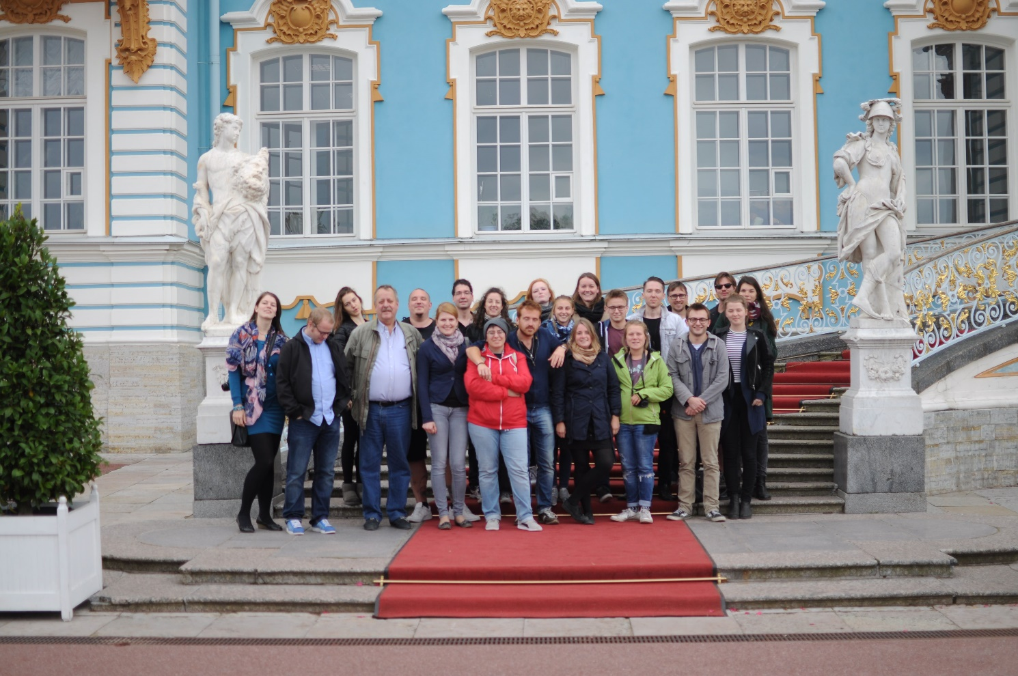
SUMMER SCHOOLS
September 8–29, 2015
International Summer School 'The Topography of Imperial Power: The Political Space of St. Petersburg'
The curriculum includes Russian language courses for foreign students, presentations, workshops, partially held in Saint Peterburg’s public space, and master classes, as well as a special cultural program in the city.
June 5-11, 2015
Summer school “Comparative Studies of Power and Diversity in Historic Empires” - within the International Research Project "Comparative Historical Studies of Empire and Nationalism”.
The program was focused on new methodologies of imperial history and studies of colonialism, new approaches to studies of politics and political imaginaries of diversity in the Russian Empire and Soviet Union in comparative perspective.
HSE UNIVERSITY ST. PETERSBURG | 26

Slide 26
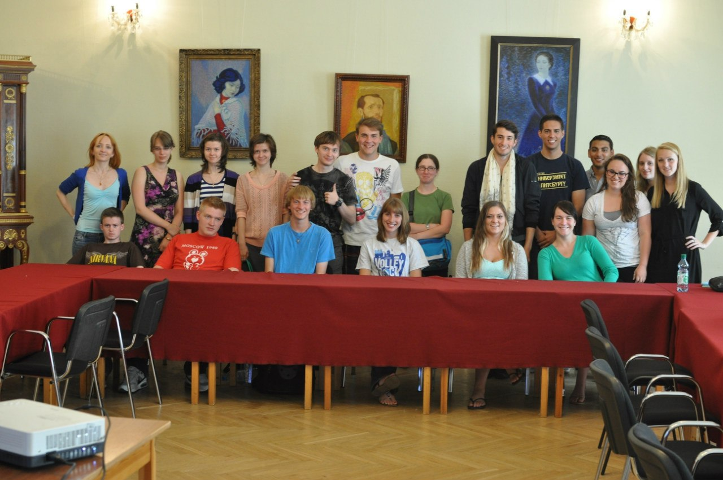
SUMMER SCHOOLS
July, 2–12, 2013
'Russia between Past and Present: Russian Politics, History and Culture in Comparative Perspective'. University of Pittsburgh and National Research University - Higher School of Economics-St. Petersburg held International Summer School in St. Petersburg.
August, 28 - 31, 2012
Third annual Summer School of the European Society for Environmental History "Natural resources: historical ideas, exploration, and exploitation" .
June, 3 - 11, 2012
"Saint Petersburg – the Capital of the Russian Empire". Joint Summer School of the Higher School of Economics, Faculty of History (St. Petersburg) and the University of Basel (Department of History, Chair of Russian and Eastern European History).
HSE UNIVERSITY ST. PETERSBURG | 27

Slide 27
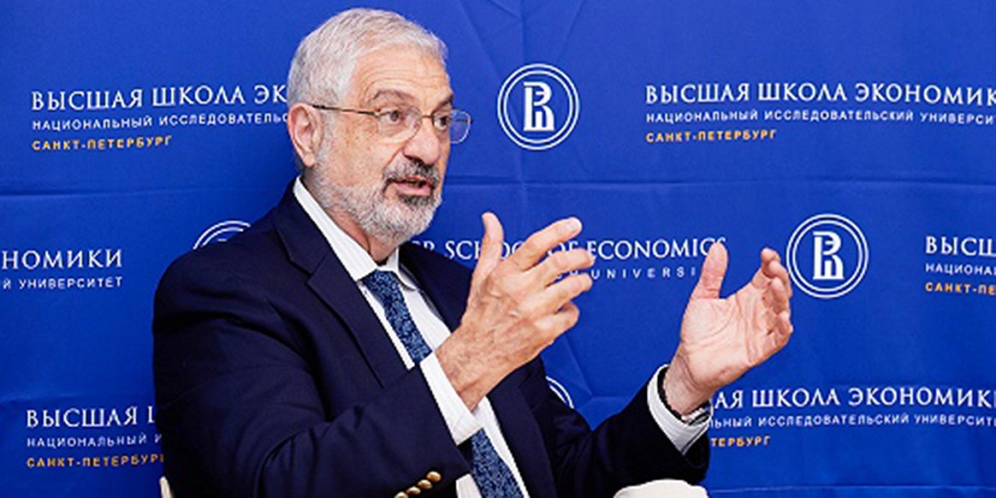
COMPREHENSIVE INTERNATIONALIZATION
«We’re trying to develop a new generation of historians who are working on what we can call the world level. Not the Western level, not the Russian level, but the world level. That is the highest possible scientific standard of writing good history».
Prof. Ronald Grigor Suny, Academic Director of the International Research Project “Comprative Historical Studies of Empire and Nationalism”, HSE - St. Petersburg, University of Michigan (Ann Arbor, USA)
HSE UNIVERSITY ST. PETERSBURG | 28

Slide 28
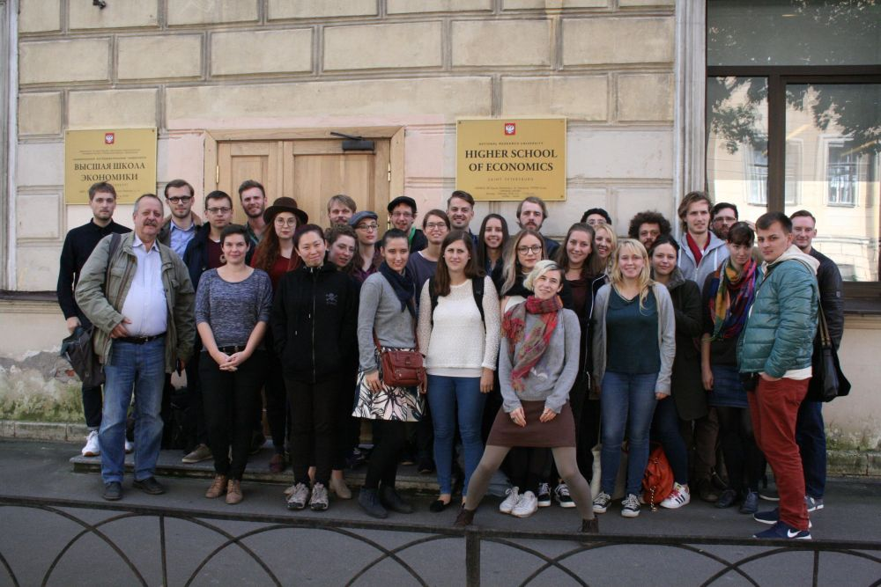
SUMMER SCHOOL
Joint Summer Schools of the Department of History supported by the DAAD:
«The topography of imperial power: the political space of Saint-Petersburg»:
September 2015 – 22 German and international students took part in the first Summer School;
September 2016 – 32 German and international students took part in the second Summer School;
The third Summer School will take place in September 2017
HSE UNIVERSITY ST. PETERSBURG | 29

Slide 29
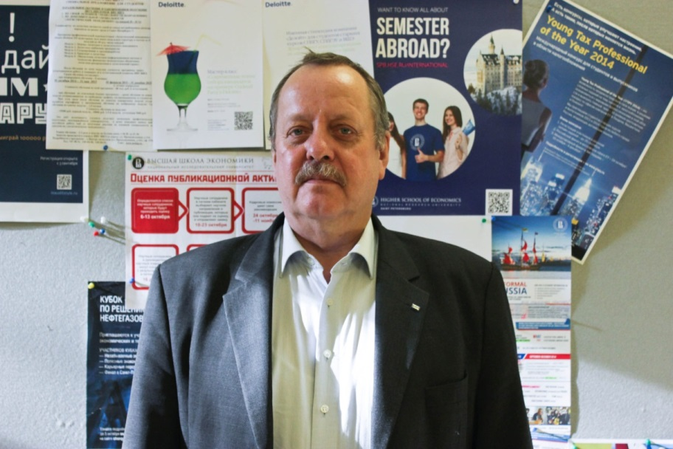
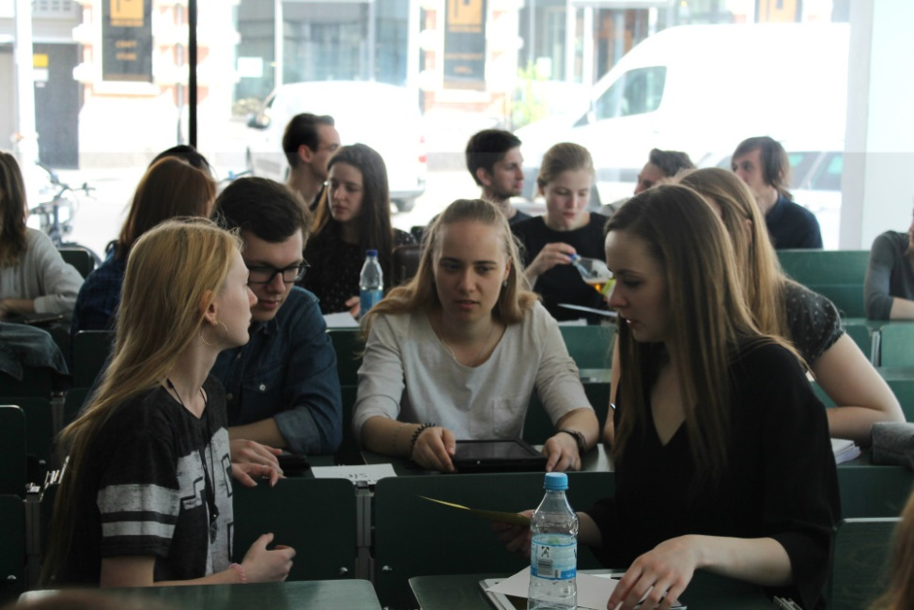
PARTNERSHIP WITH DAAD
A long-term associate professorship at the HSE Department of History in St. Petersburg in May 2014. Dr. Dietmar Wulff (Bielefeld University, Voronezh State University in Russia, HSE-Saint-Petersburg).
Joint seminars with German Universities:
July 2015 – 14 Russian students received a grant from DAAD to take part in a joint seminar with students from Humboldt University in Berlin and Bielefeld University;
July 2015 – seminars at HSE Saint-Petersburg for 11 postgraduate students from Humboldt University in Berlin.
May-June 2016 –a joint seminar between students of the History programme and students from Humboldt University in Berlin; the seminar was called “Turning times: Germany anв Russia in 1980-2000”.
HSE UNIVERSITY ST. PETERSBURG | 29

Slide 30
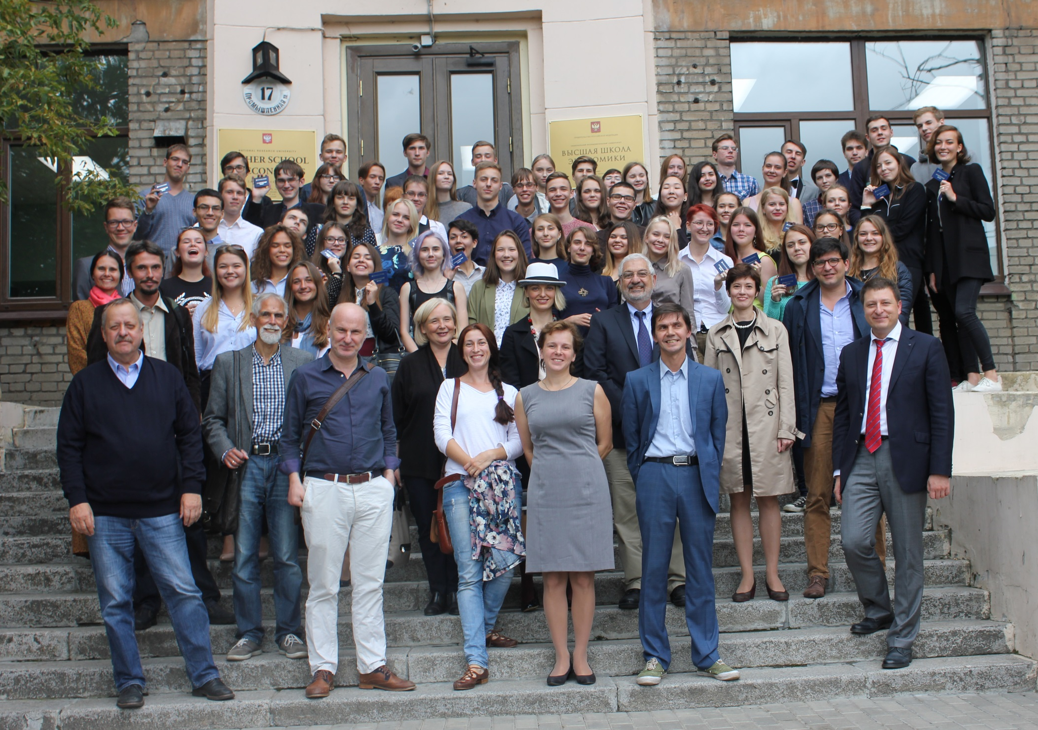
Official Web Page of HSE University St. Petersburg:
http://sh.spb.hse.ru/en/history/
More information about research events and ongoing projects:
https://spb.hse.ru/en/62317322/socschl/history/seminar
Center for historical research:
http://sh.spb.hse.ru/en/chr/
https://https://www.facebook.com/istoria.sanktpeterburg
@History in St. Petersburg (История Санкт-Петербург)

