Slide 1
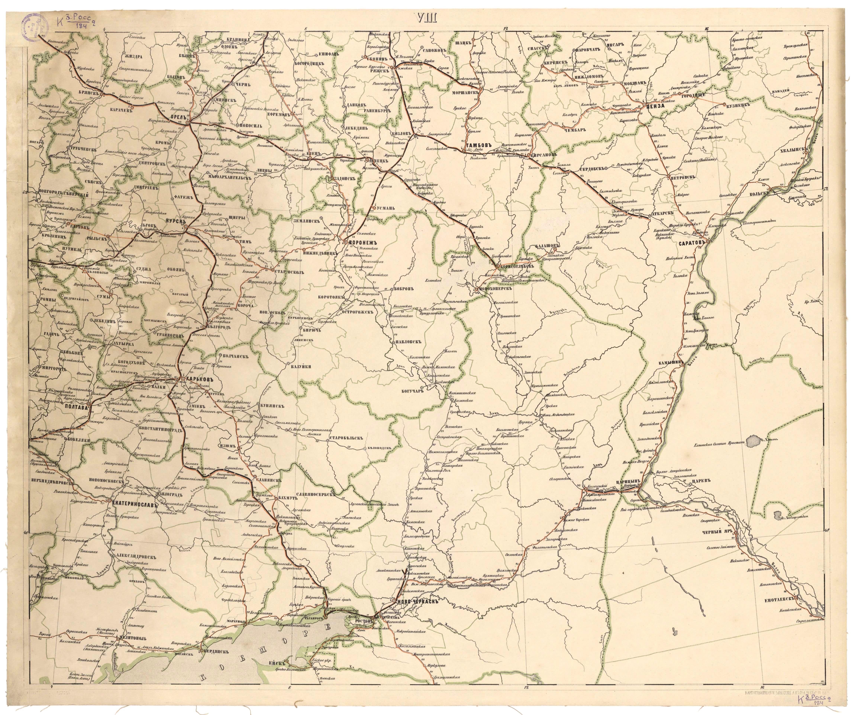
The International Postal Exchange in the Nineteenth Century: the Postal Treaties between the Russian Empire and the Kingdom of Prussia
Sergey Mikhaylov
Department of History
National Research University
Higher School of Economics
St. Petersburg

Slide 2
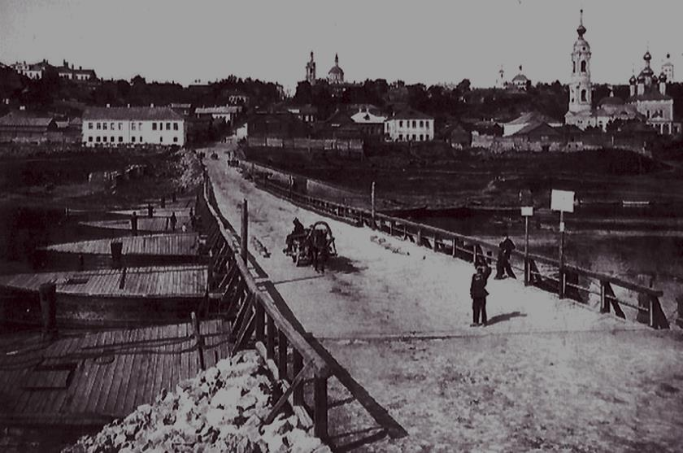
The Development of Postal Communications and Networking the World
A great part of the history of contacts and interactions between civilizations
Basis for the telegraph system
Universal Postal Union

Slide 3

The Russian Empire and the Kingdom of Prussia
Prussia as the main postal partner for the Russian Empire
Russian-Prussian postal treaty of 1821

Slide 4
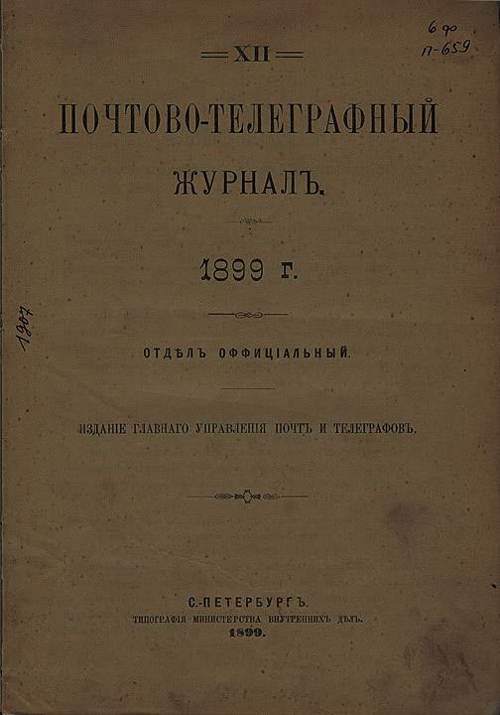
Sources
13 postal treaties and one additional act
Collection of laws and resolutions of the General Department of Posts and Telegraphs
The Postal-Telegraph Journal

Slide 5
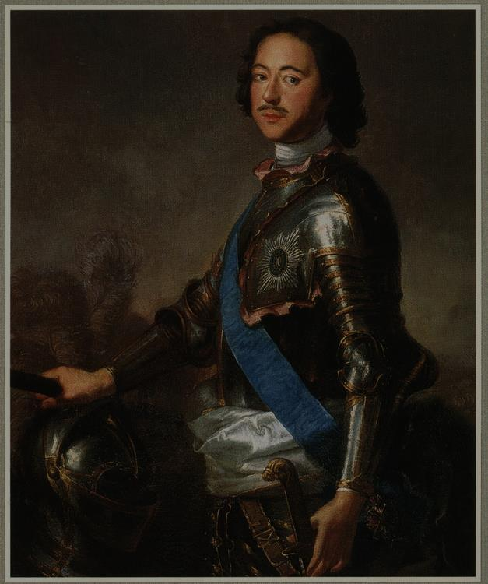
Beginning of Postal Relations with Prussia
18th century, Peter the First, Saint Petersburg
Privy secretary Bertram, 1722
Postal road Memel-Riga-Reval-Narva-Saint Petersburg-Moscow
70 000 thalers income instead 5 000

Slide 6
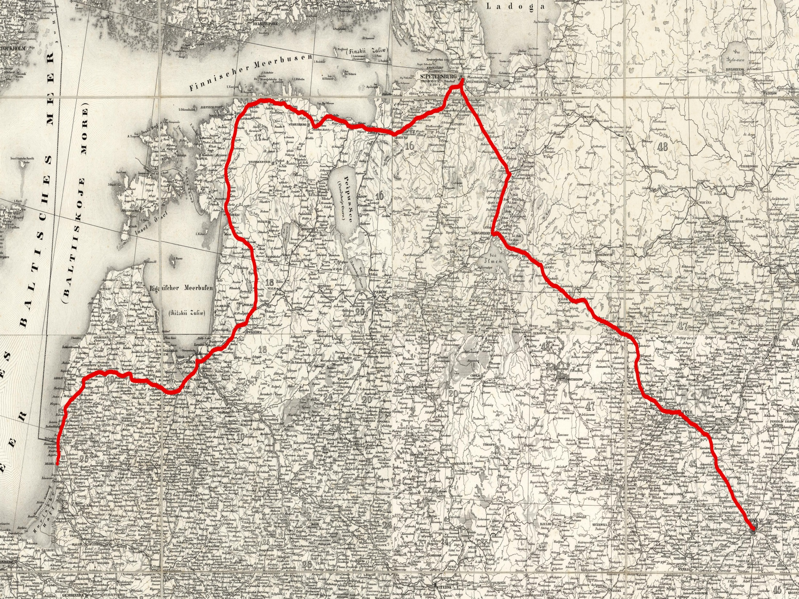
Shubert, Fedor Fedorovich // Composite: Sheets 1 - 16 Kriegsstrassen Karte eines Theiles von Russland (http://www.davidrumsey.com/)

Slide 7
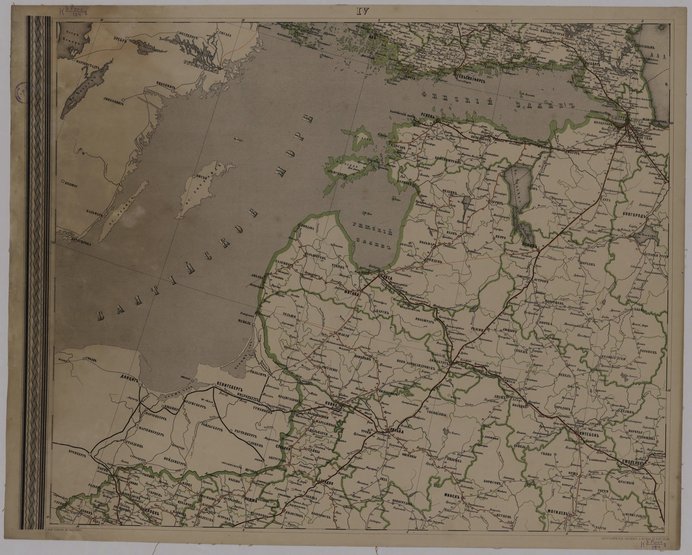
Struggle for the Russian Postage
Saxony, Hesse and Munster
Postal road Amsterdam-Munster-Kassel-Leipzig-Sorau-Warsaw-Saint Petersburg
Saxon Ober-Mail-Commissioner Renner

Slide 8
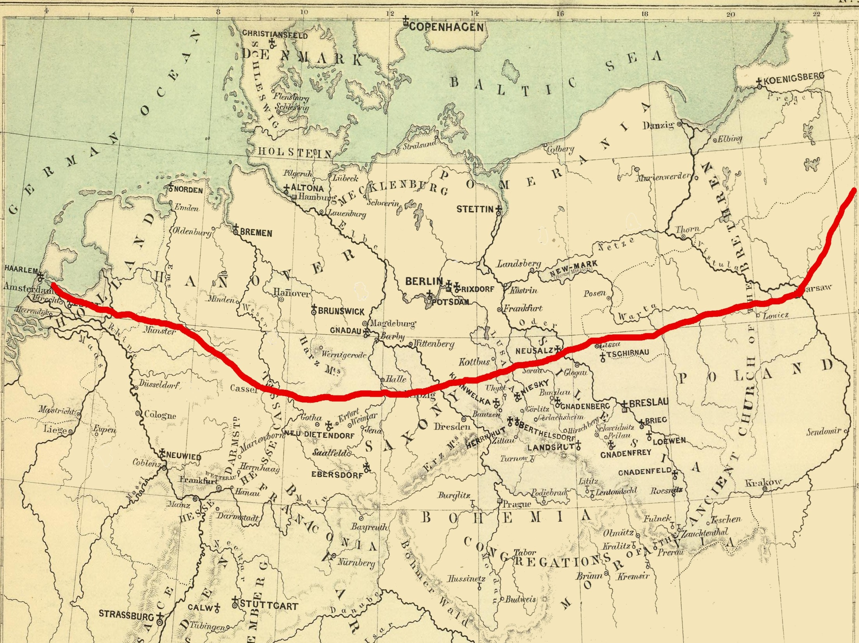
Peterson, Augusts; Fullback Academy // Germany, Switzerland, Holland. (http://www.davidrumsey.com/)

Slide 9
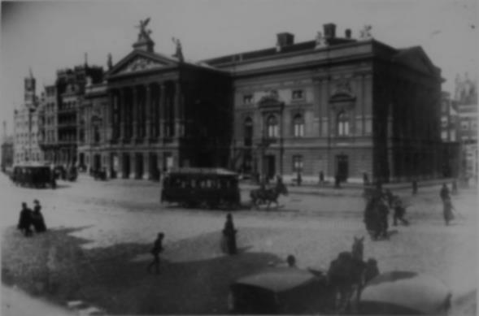
Failure of the Plan
Bribed official of Renner
Prussian authorities accelerated mail delivery from Berlin to Amsterdam; the Prussian mail reached Amsterdam before the exchange opened

Slide 10
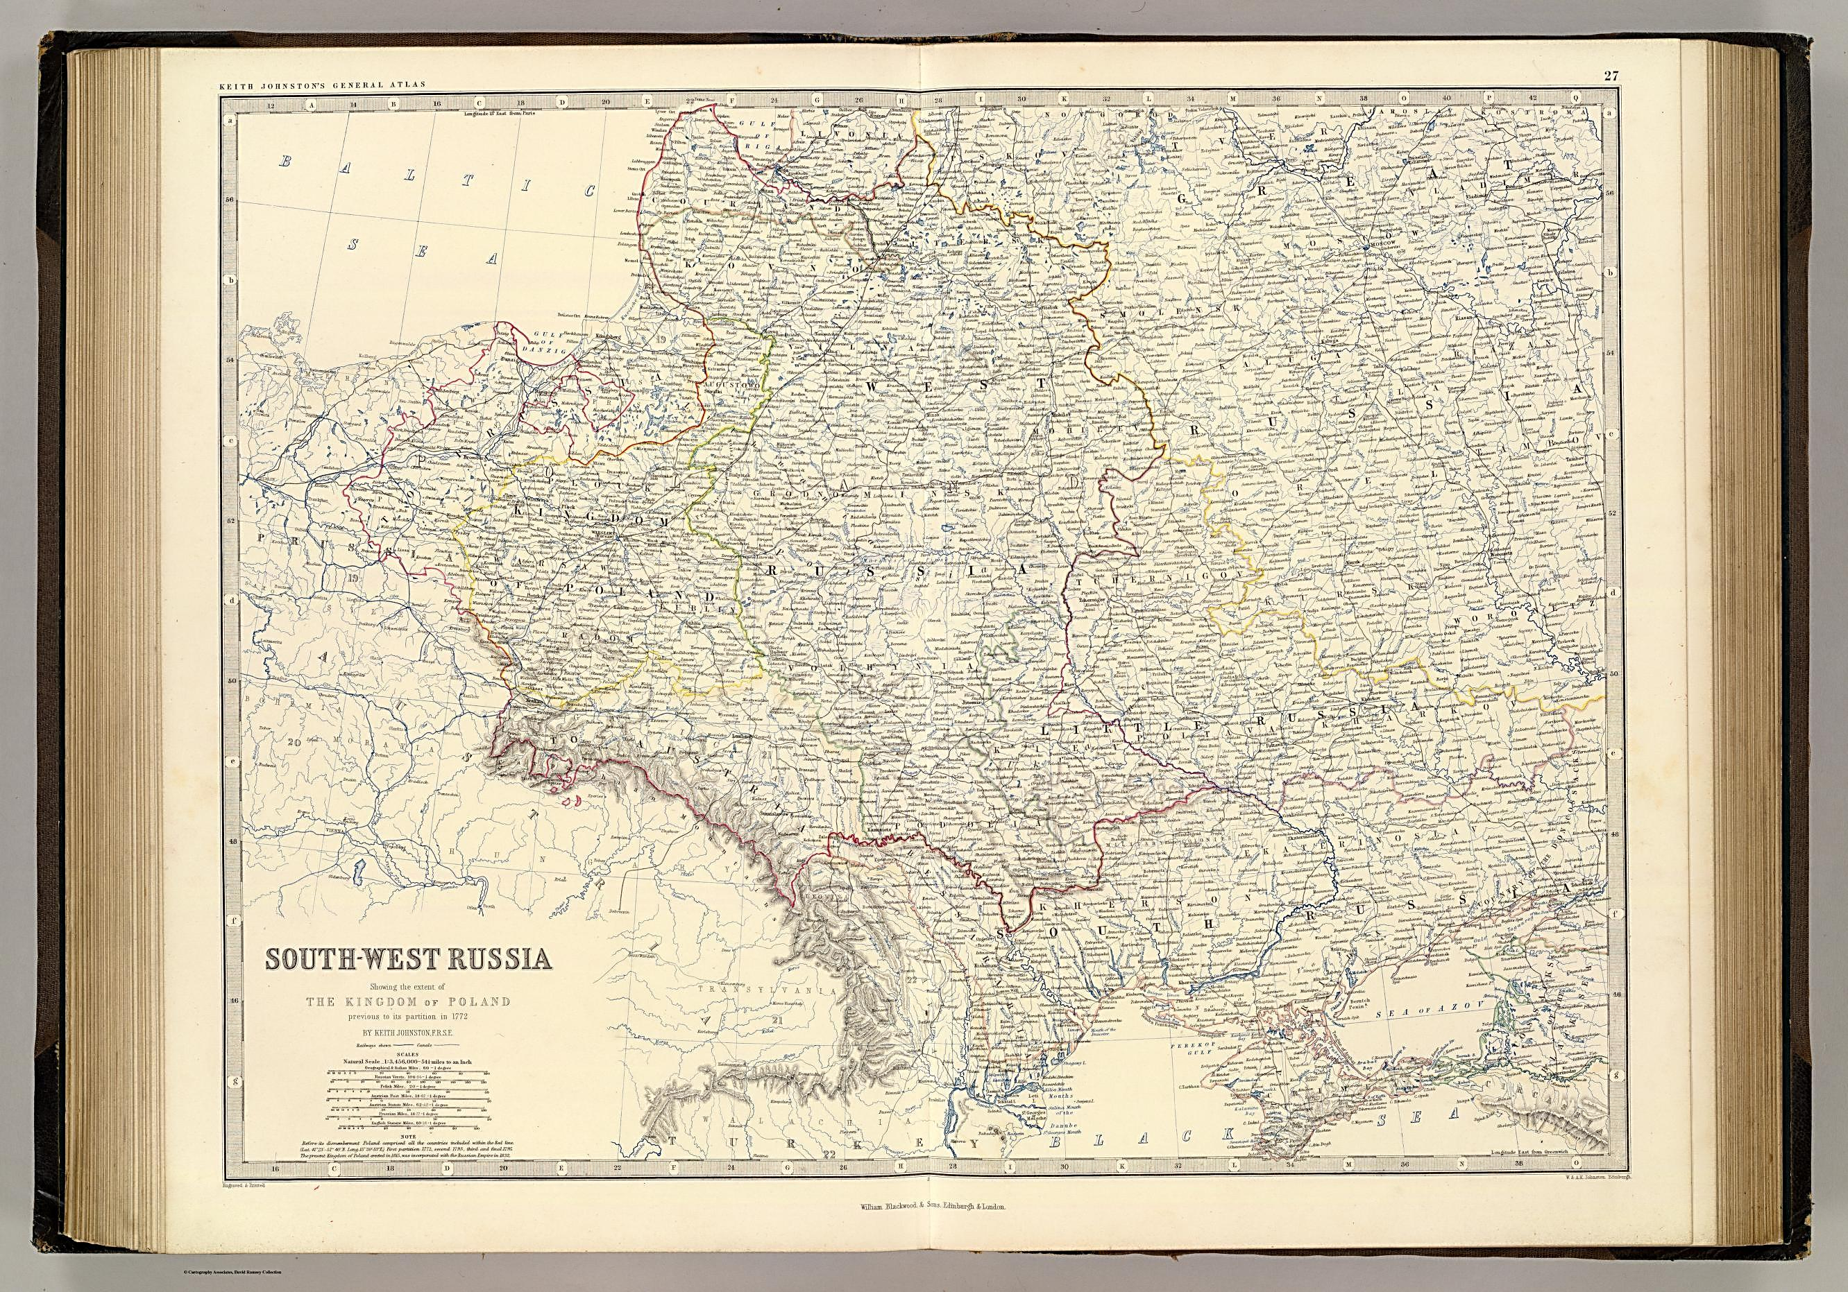
Another attempt to redirect flows of mail from Russia to Europe
Mail and packages from Russia to France,
the Netherlands and South Germany through the territory of Poland, Austria, Saxony and Bayern instead Prussia
Trade route

Slide 11
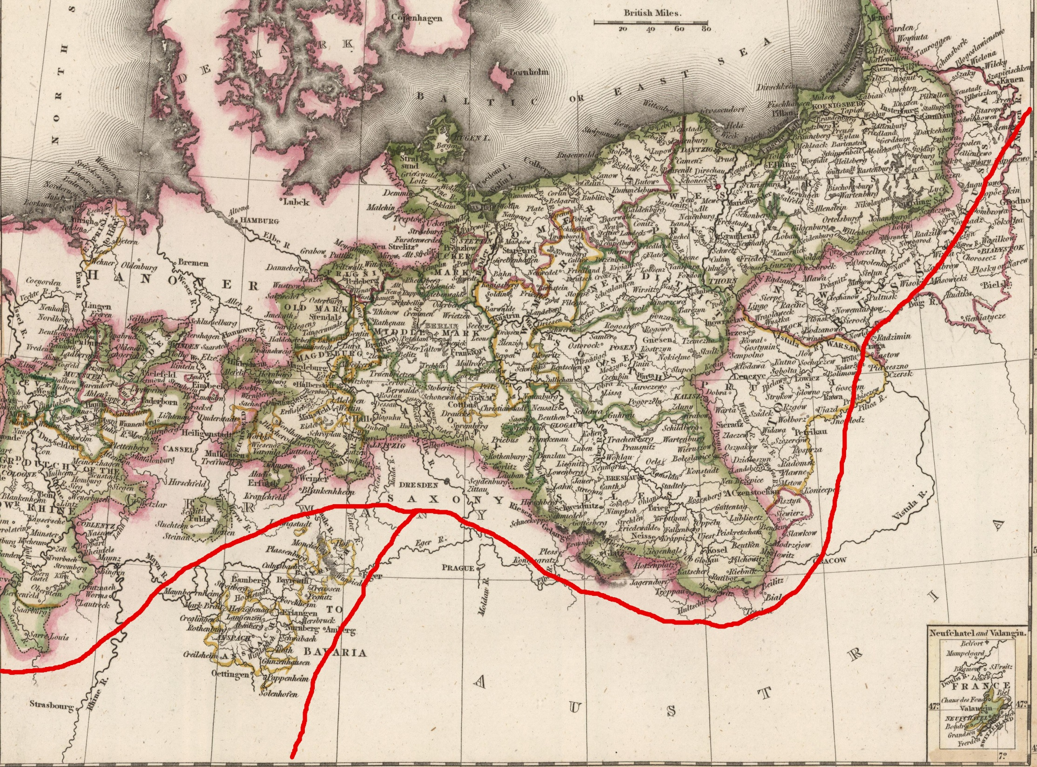
Arrowsmith, Aaron; A. Constable & Co // Prussia (http://www.davidrumsey.com/)

Slide 12
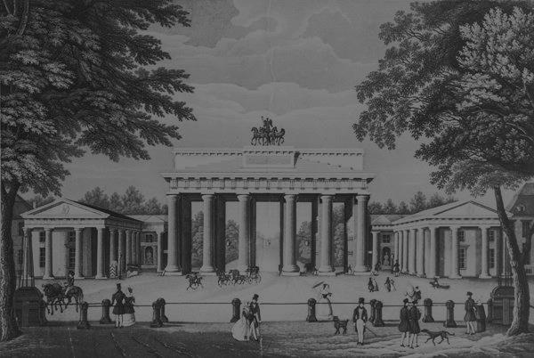
Prussian actions in 1820
transformed and improved the system of postal roads which were used for the Russian post
the network of secondary roads were rebuilt and renovated

Slide 13
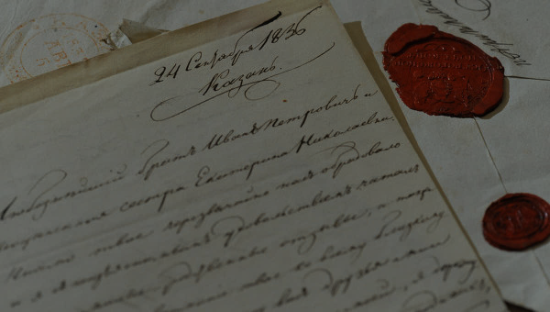

The Russian-Prussian postal treaty of 1821
Prussia got a control over the Russian mail flows
BUT very beneficial for the Russian Empire until an active use of ferries for transporting mail
Geographical position
Quality of roads
Great profits from the postal exchange

Slide 14
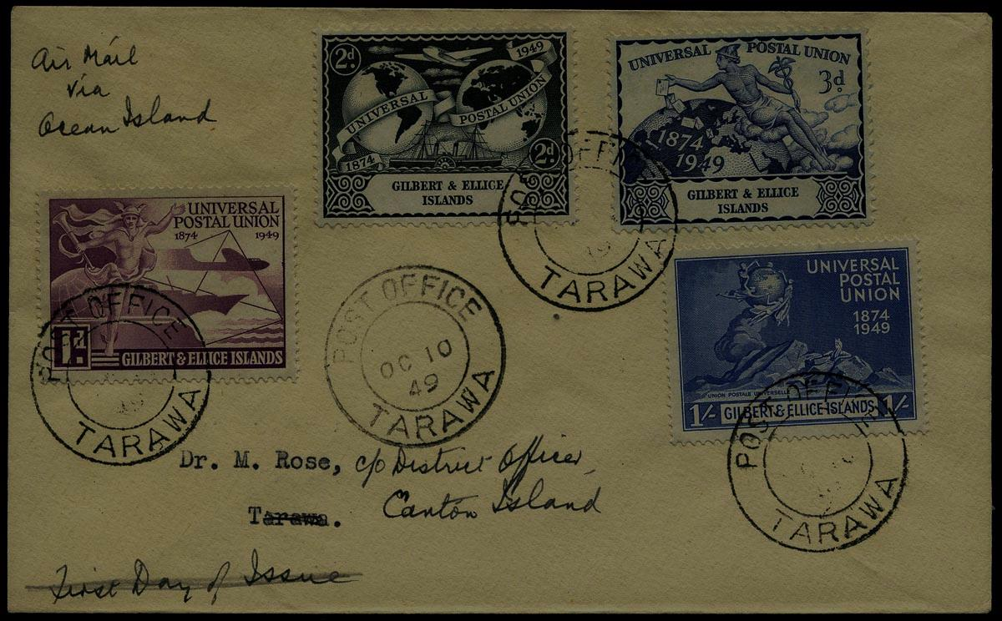
Research perspectives
The making of postal unions
The role of public and private institutions in the developing of postal communications
Economic struggle

Slide 15
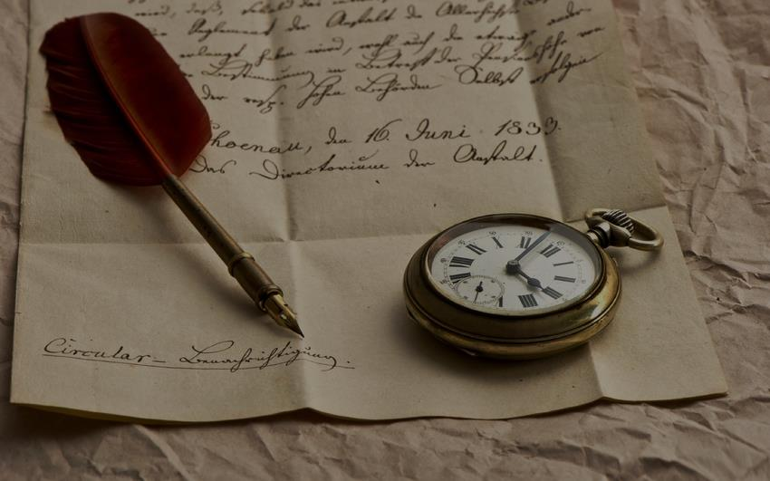
Thank you for attention!

