Slide 1
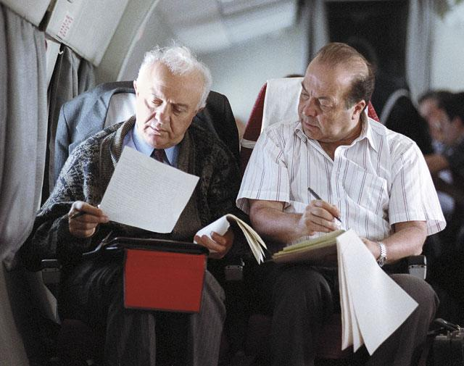
The Soviet speechwriters on the example of the Diaries of
Teimuraz G. Stepanov-Mamaladze

Slide 2
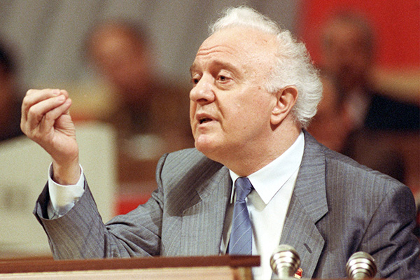
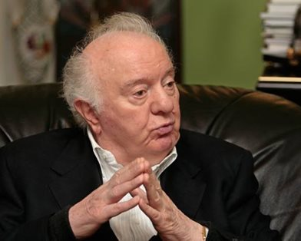
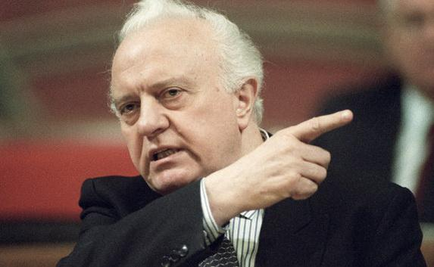
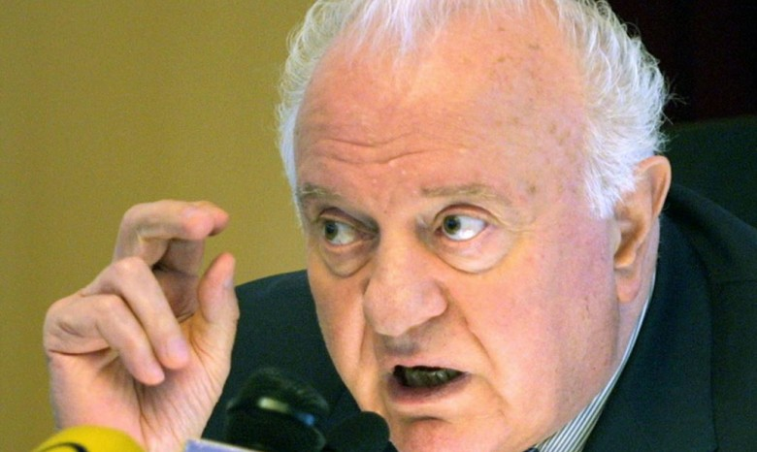

Slide 3
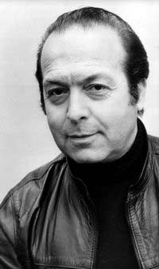
Teimuraz Stepanov-Mamaladze
(1934-1999)
Was born in Tbilisi (Georgia)
Graduated from the Moscow State University Law School in 1958
Was a director of the Georgian Information Agency (Gruzinform)

Slide 4
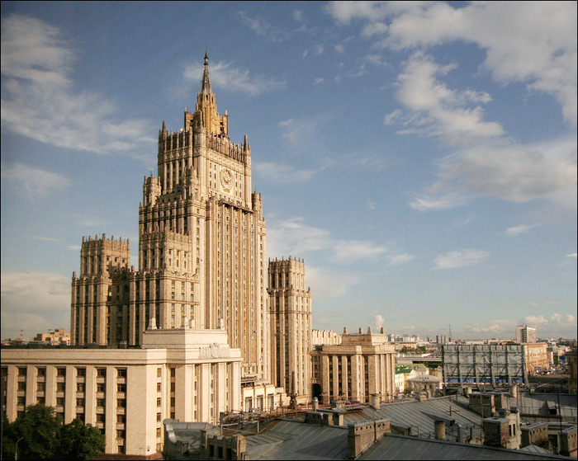
The first day. The day of landing on the planet MFA. I am surrounded by aliens. Their speeches, their language is not clear to me. It is hard to imagine that I master it.

Slide 5
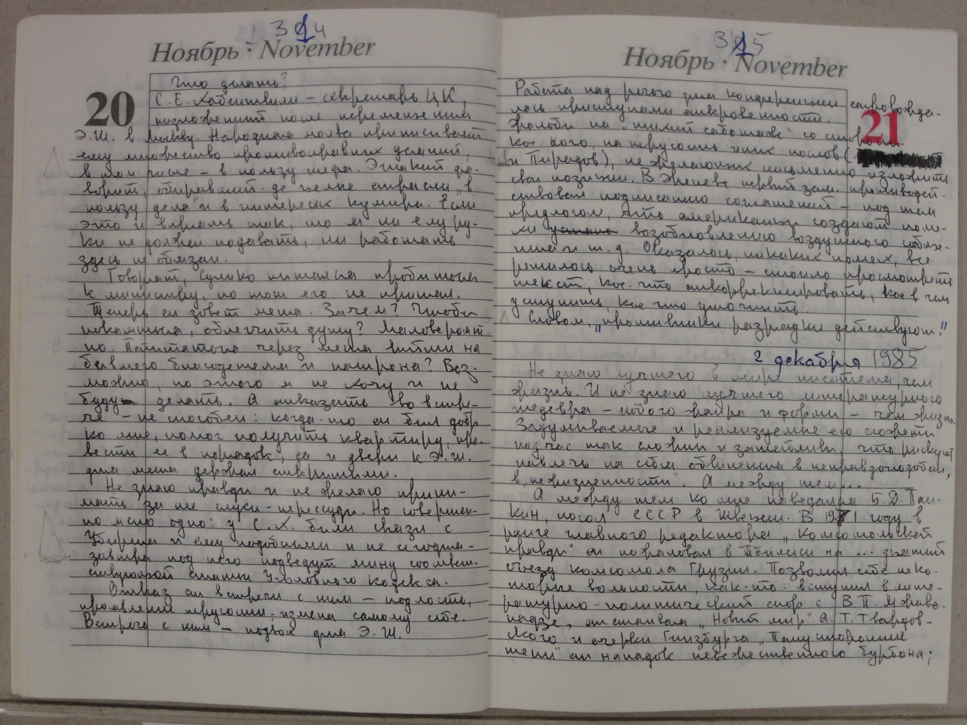

Slide 6
